Slide 1
ARCADE MINI Accessory for Nintendo Switch
PRESENTS

Slide 2
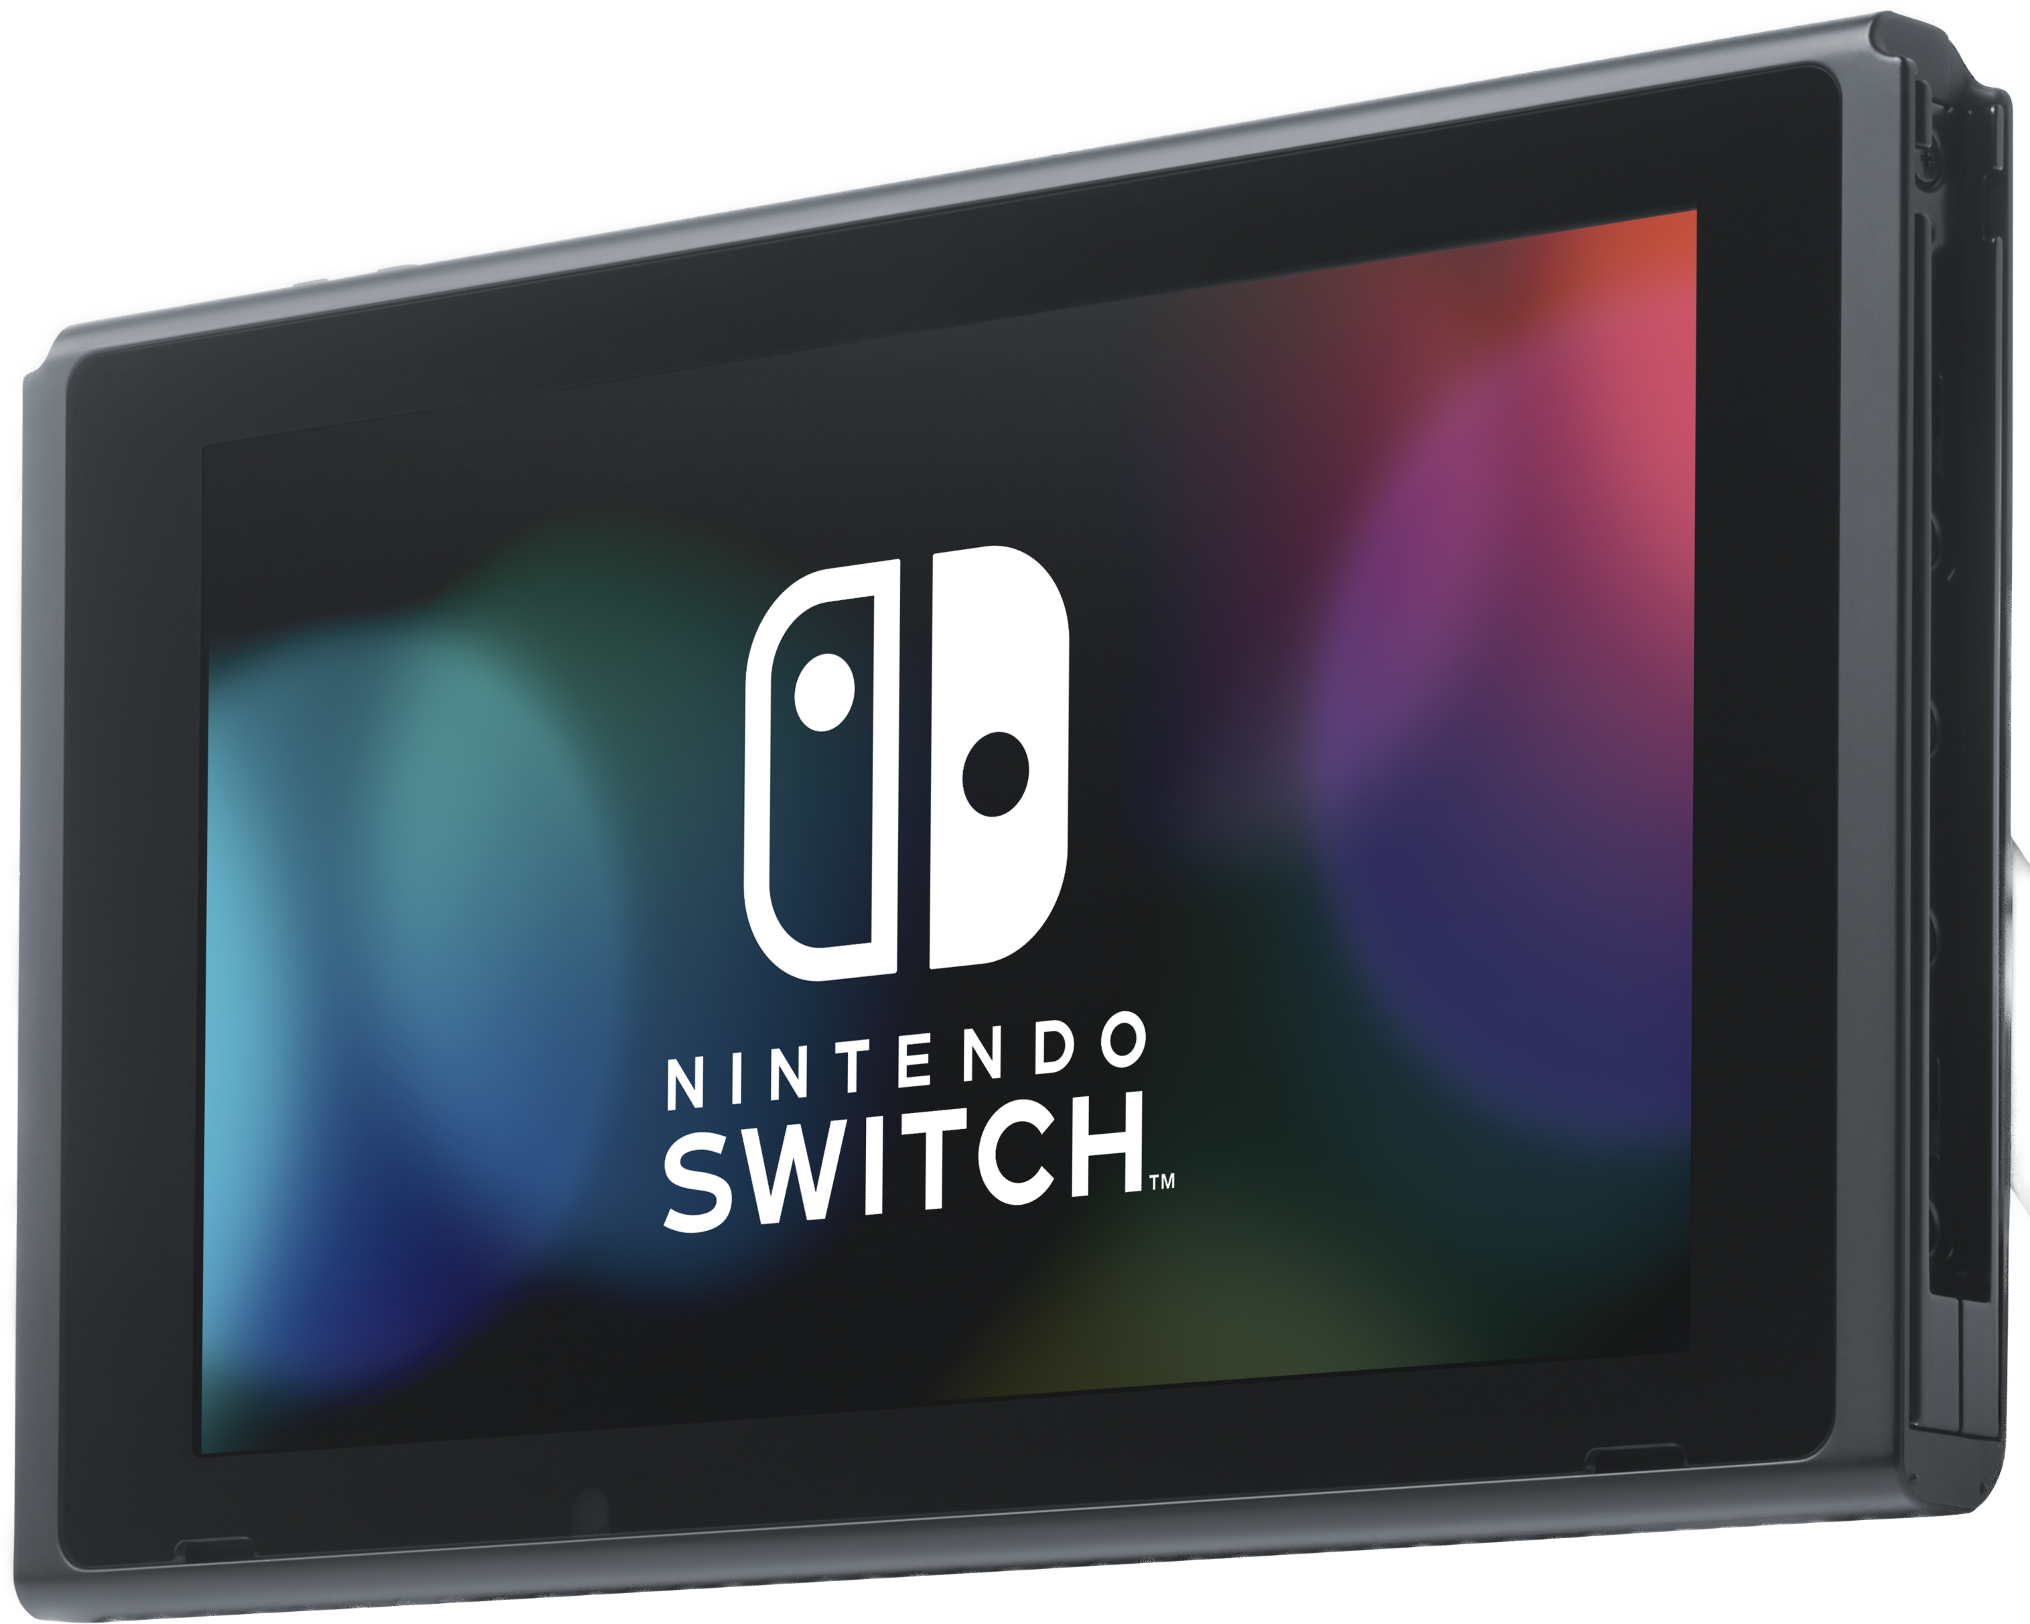
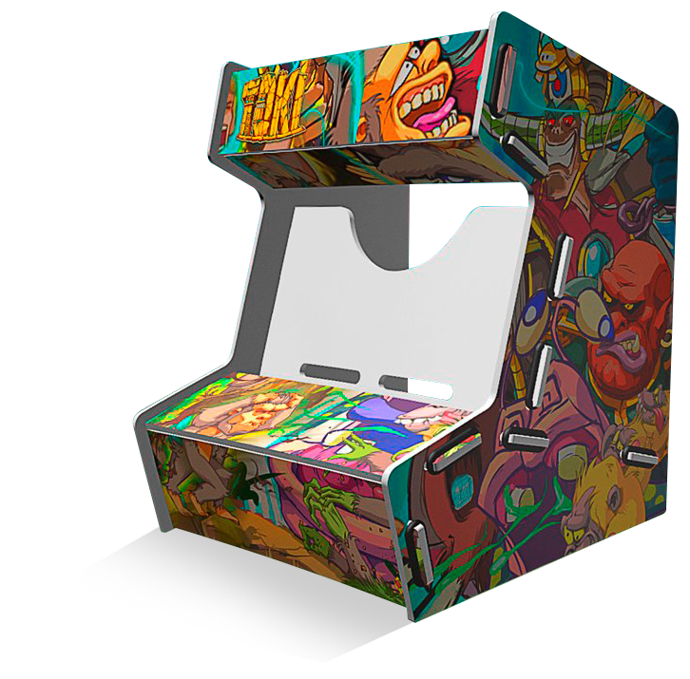
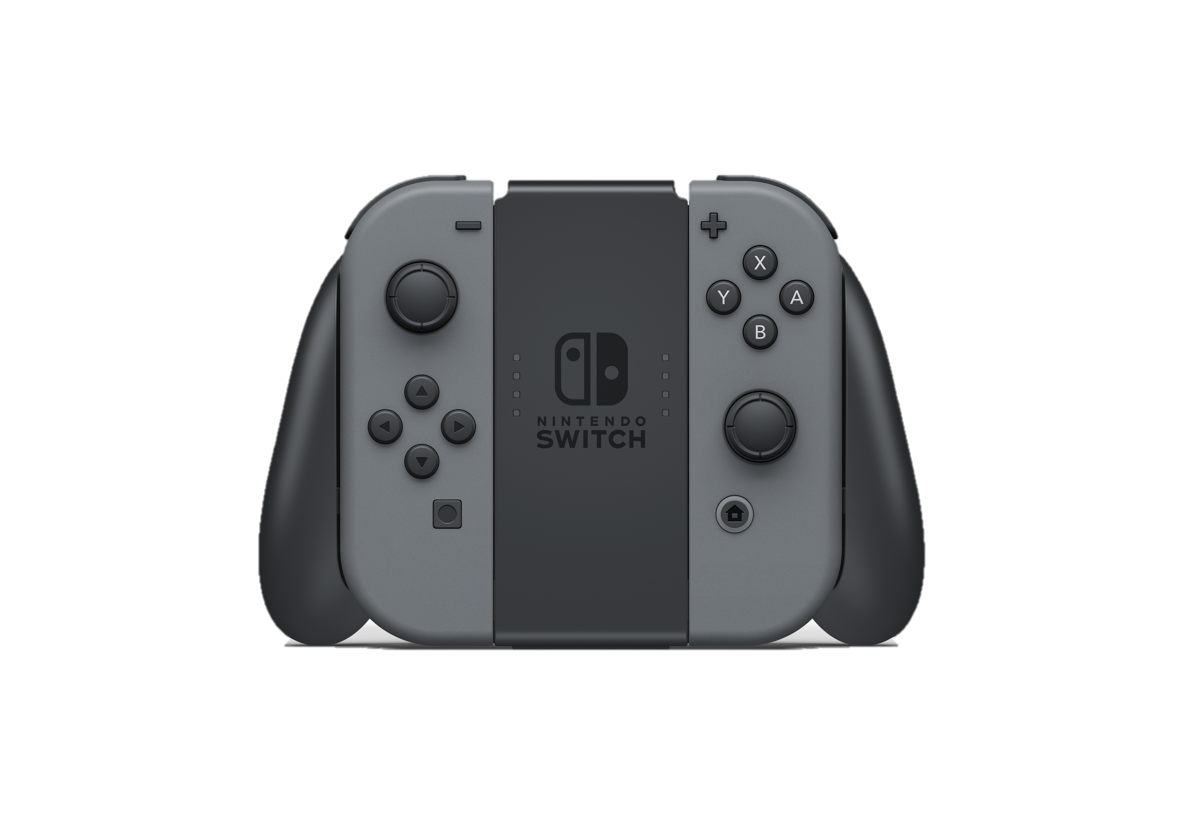
Concept
Printed wooden Arcade Mini
DIY trend = building the cabinet out from the box
Why Nintendo Switch?
25+ M units worldwide at the end of December 2018
Fastest selling console ever in the US (over 1 year)
Surfing on the Nintendo Labo DIY concept
Tablet mode benefiting from the concept
Why an arcade cabinet?
Retrogaming trend
Targeting a specialist audience with famous franchises
Accessory as much as a collector item
Playable deck
1
Anuman Interactive 2018 – Confidential material – Do not share

Slide 3
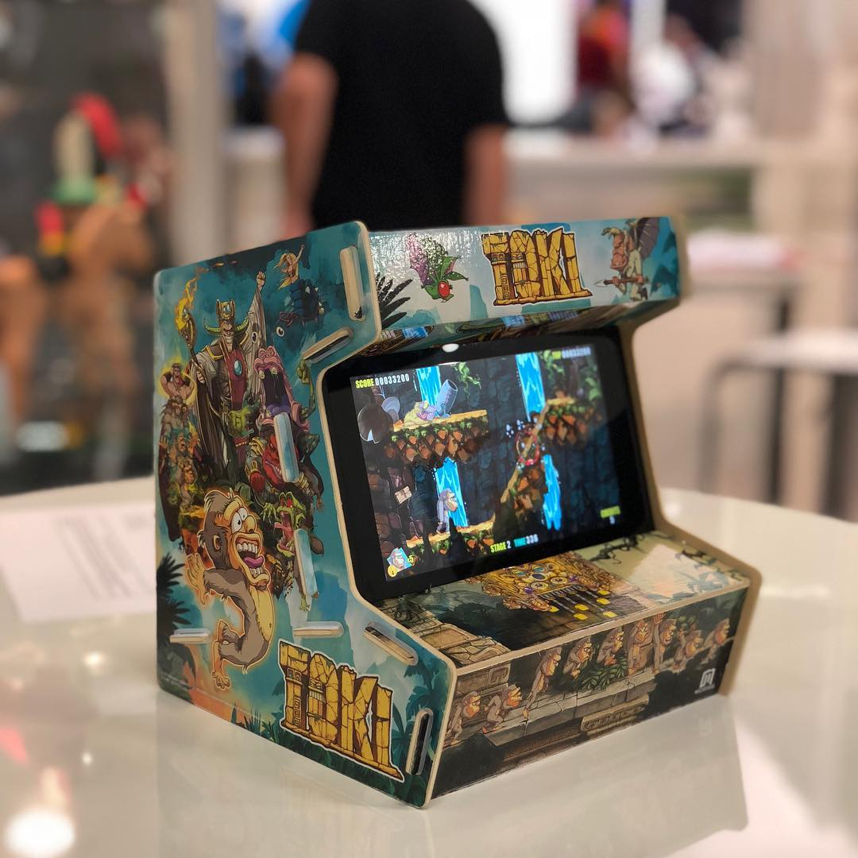
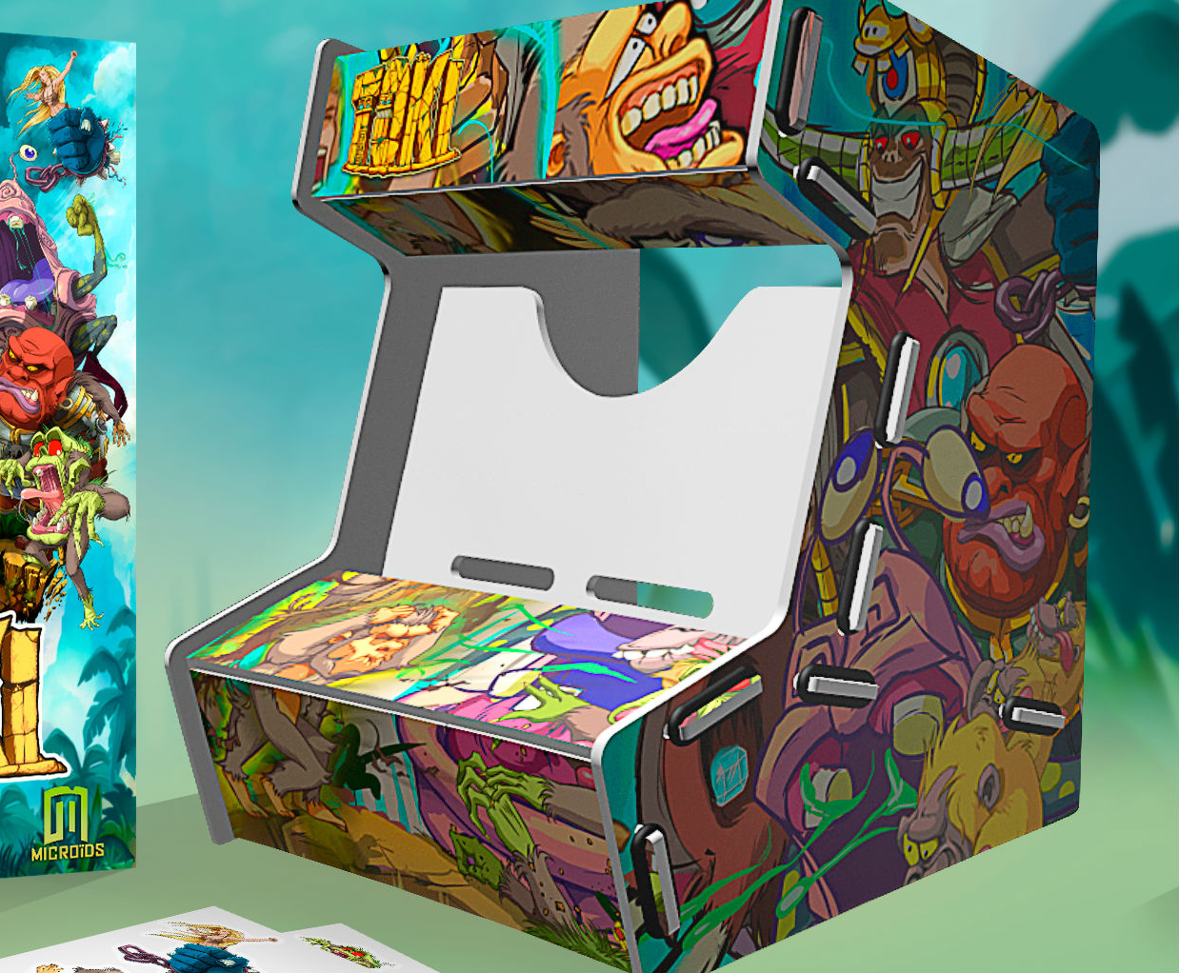
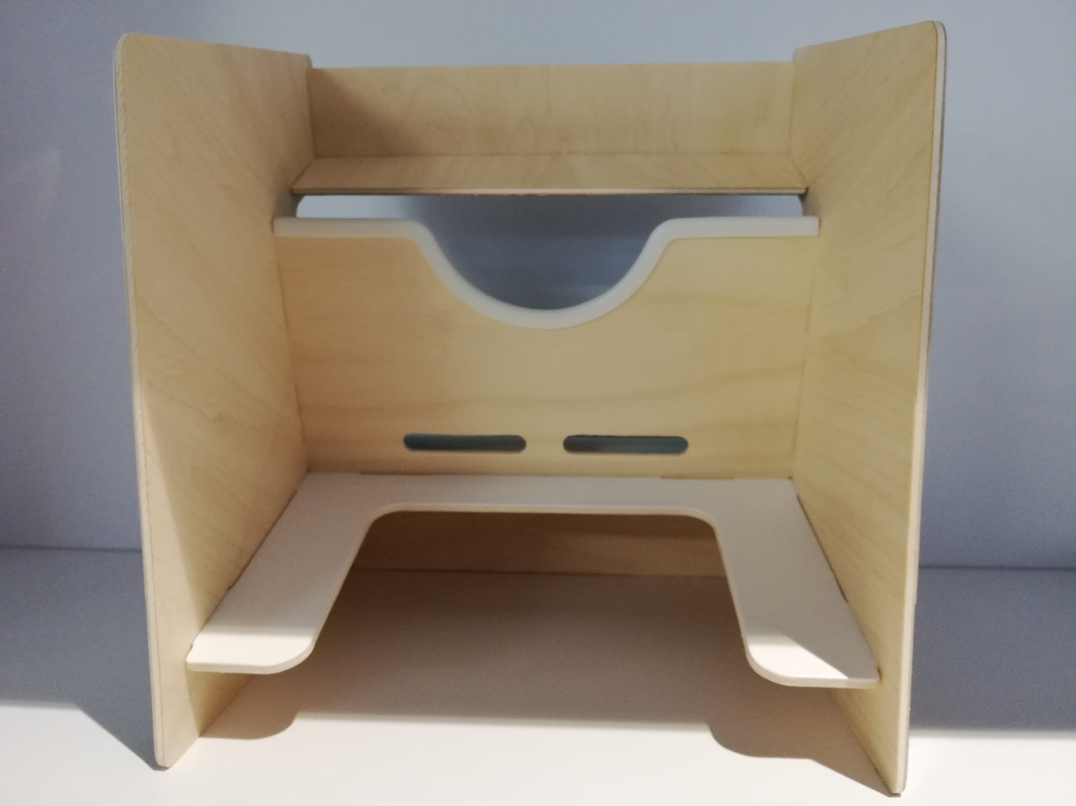
Technical specs
Box dimensions
Franchise-branded box for each cabinet.
215 mm high
185 mm wide
17 mm deep
Visuals are high quality prints and not stickers
SIDE A
REAR VIEW
SIDE B
2
Anuman Interactive 2018 – Confidential material – Do not share

Slide 4
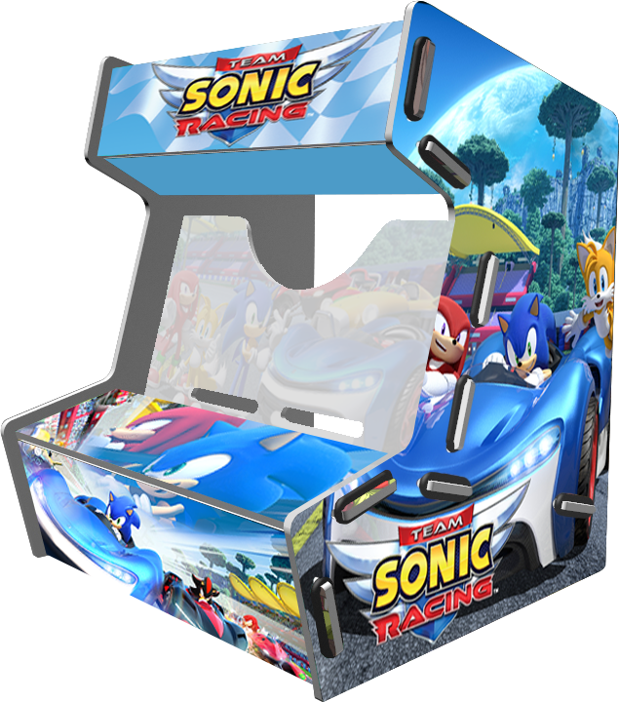
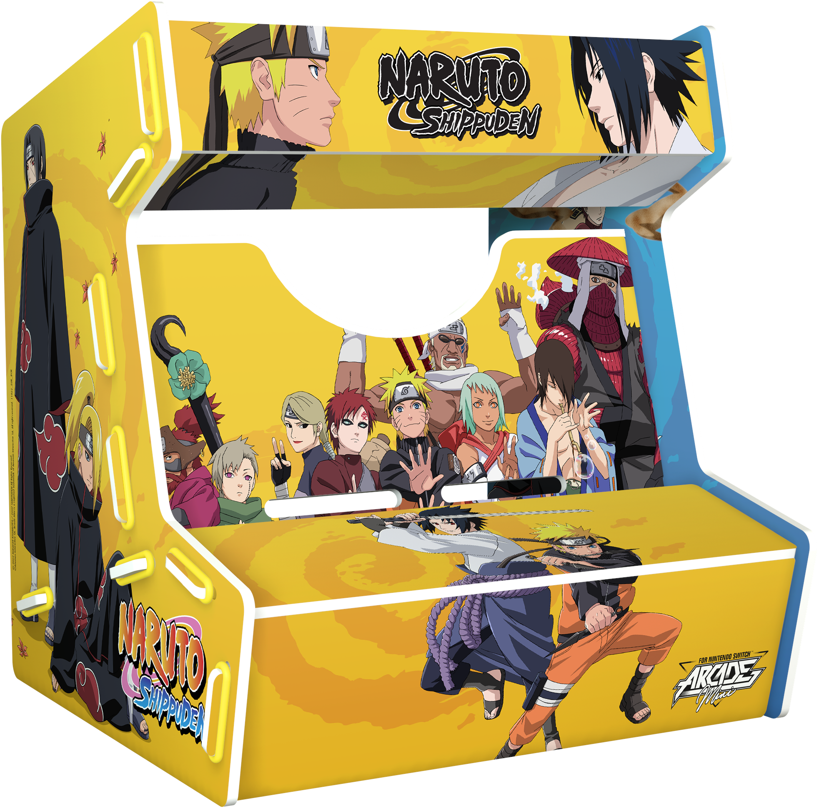
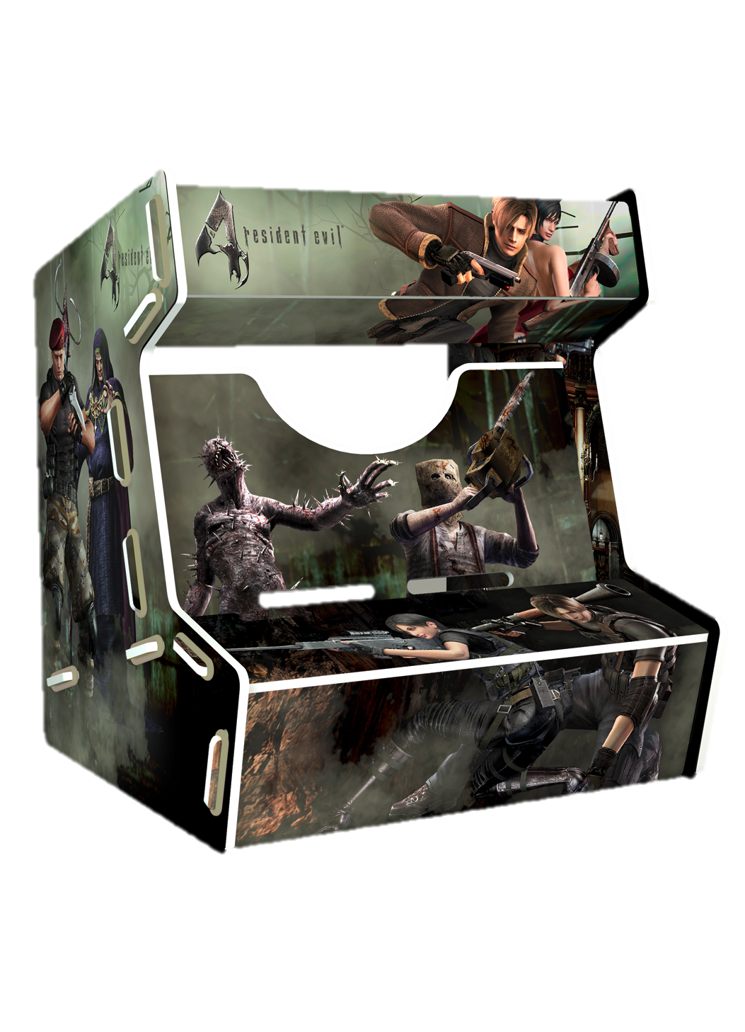
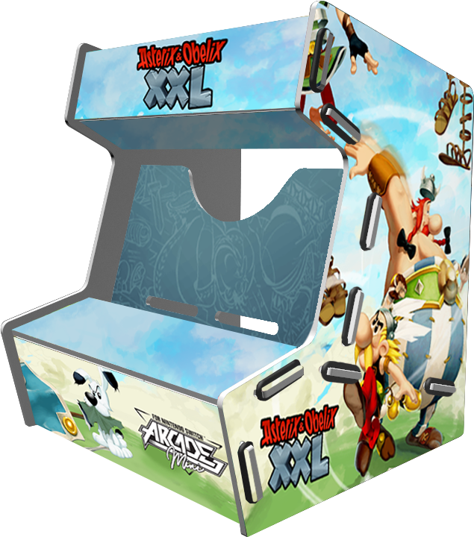
Release schedule
Up to 10 branded cabinet series by the end of 2019
Famous IPS from the Manga and/or the Videogame universes
Future potential Ips from the sport industry
November 2018 (reminder)
Oct/Nov 2019
3
Anuman Interactive 2018 – Confidential material – Do not share
ALL LOGOS, NAMES & BRANDS USED IN THIS PRESENTATION ARE EXCLUSIVE PROPERTY OF THEIR RESPECTIVE OWNERS.

Slide 5
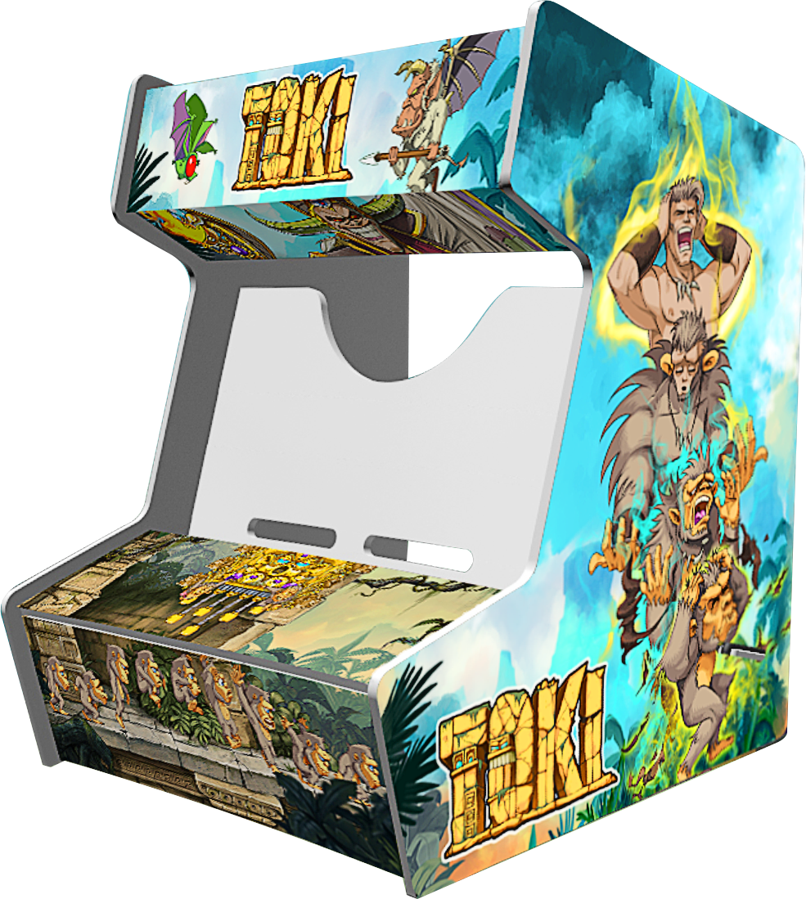

Slide 6
4

Slide 7
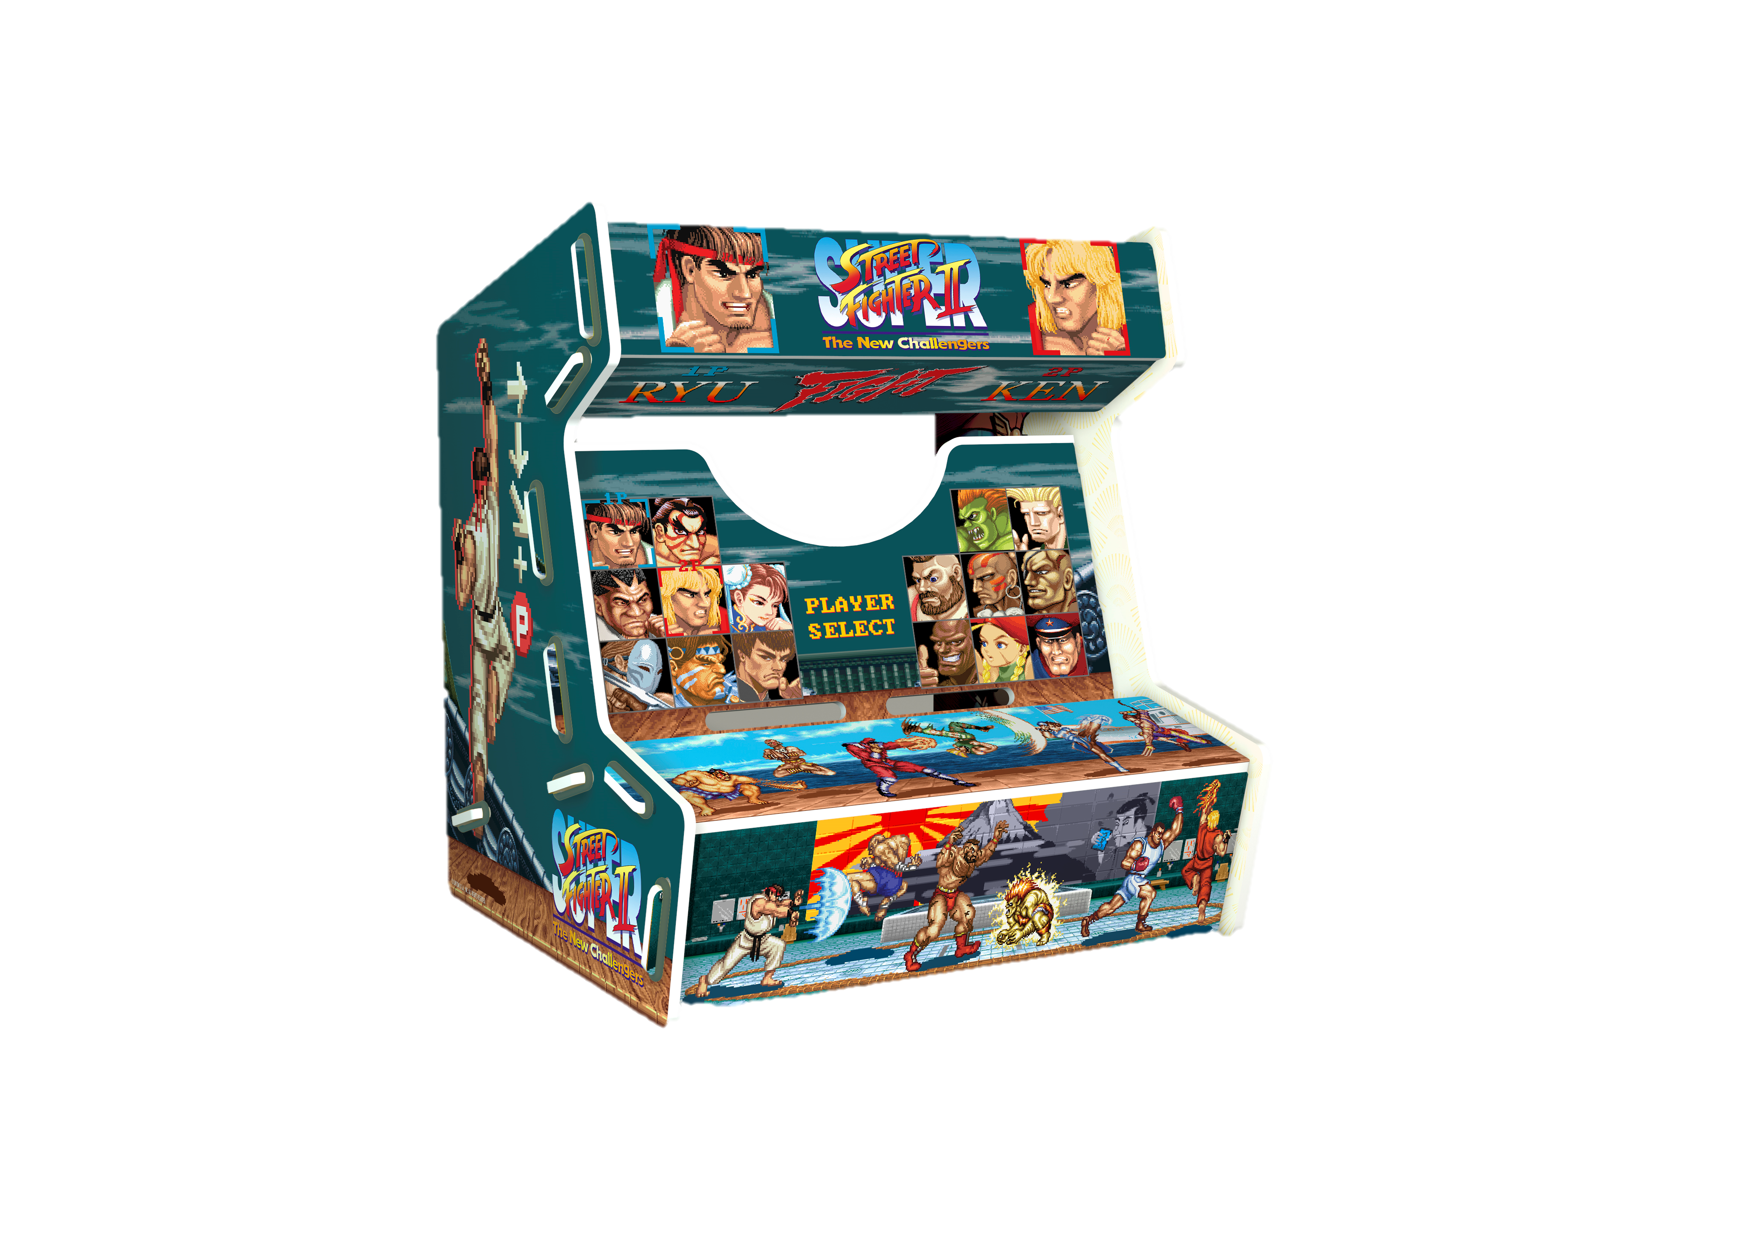
5

Slide 8
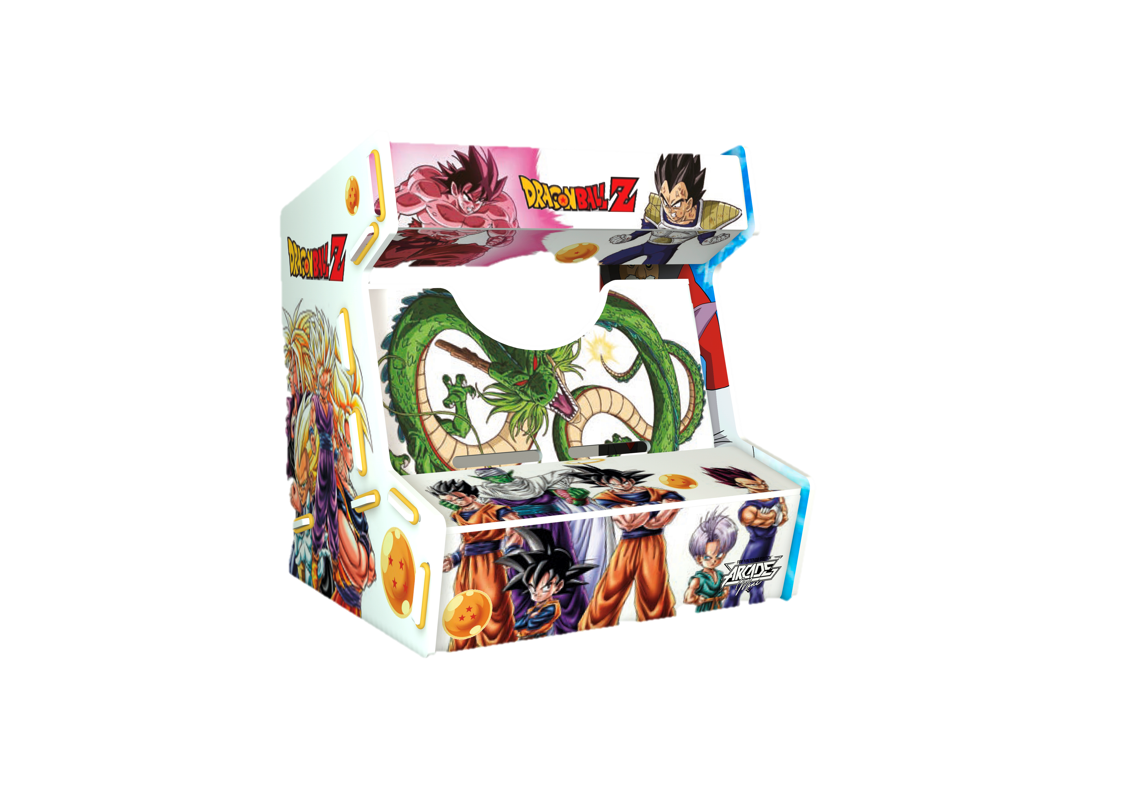
7

Slide 9
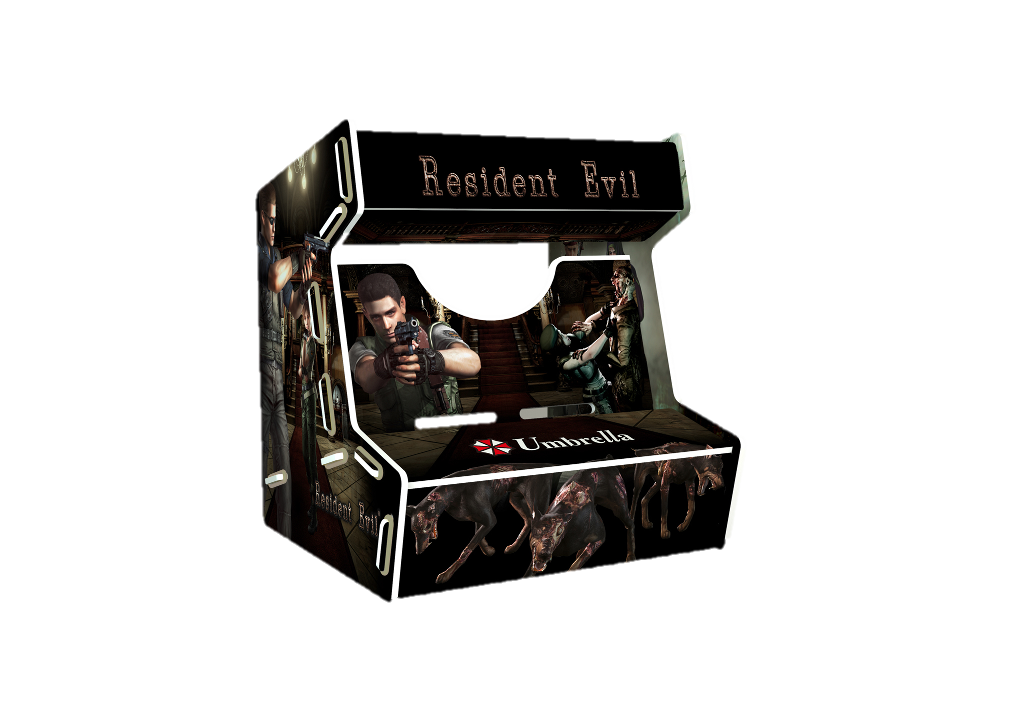
6

Slide 10
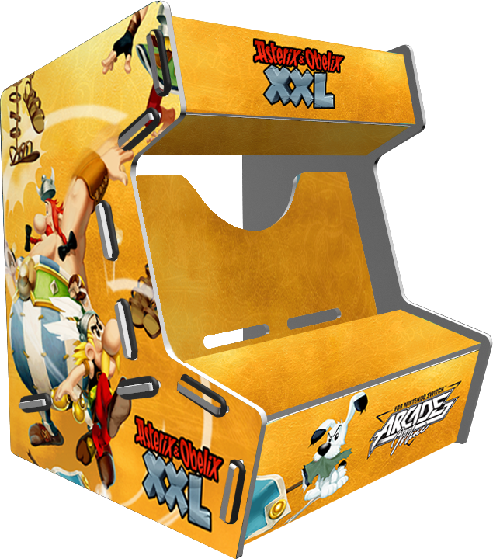
8

Slide 11
TBC
9

Slide 12
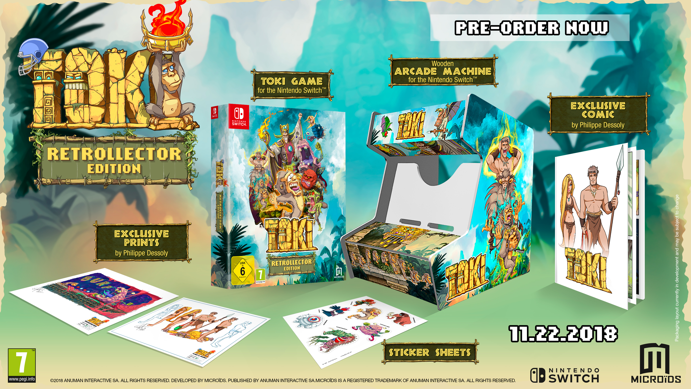
First designs
TOKI
10
Anuman Interactive 2018 – Confidential material – Do not share

Slide 13
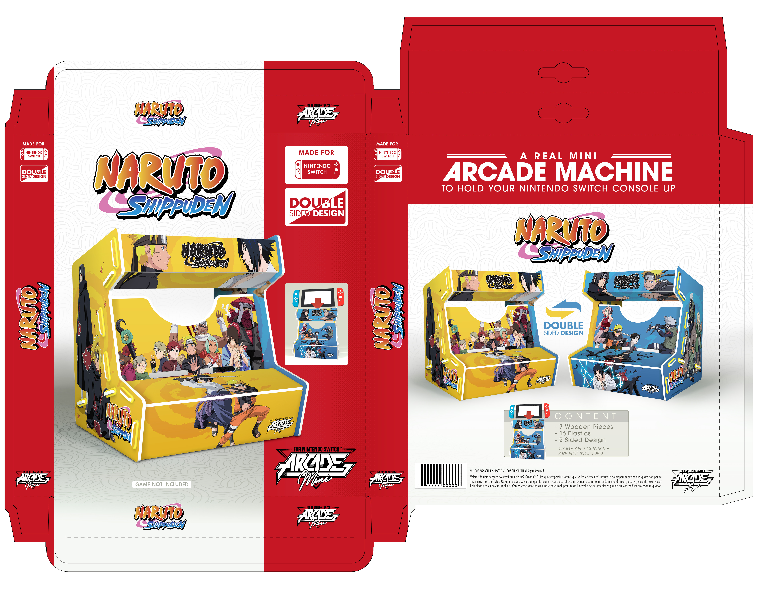
Packaging(tentative)
11
Anuman Interactive 2018 – Confidential material – Do not share

