Slide 1
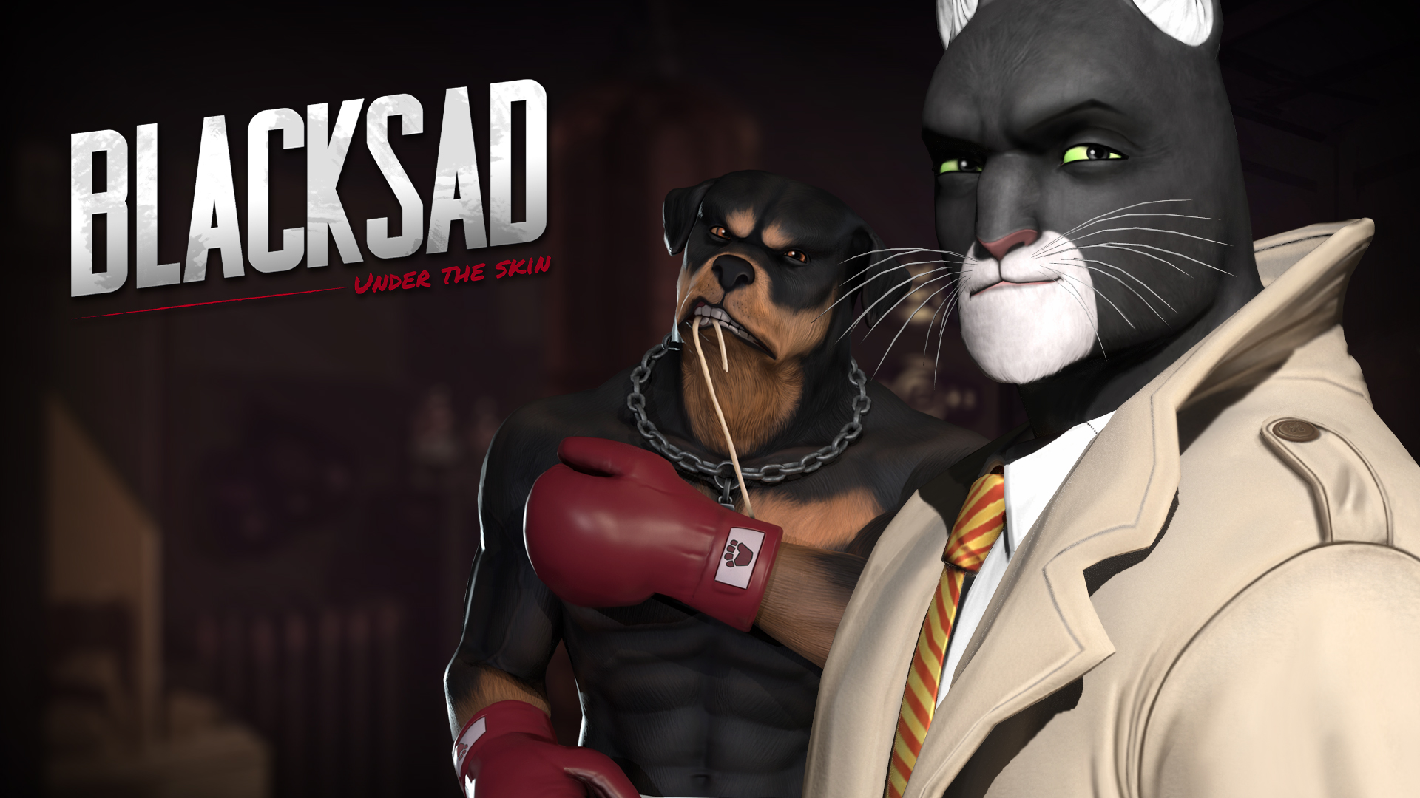


Slide 2















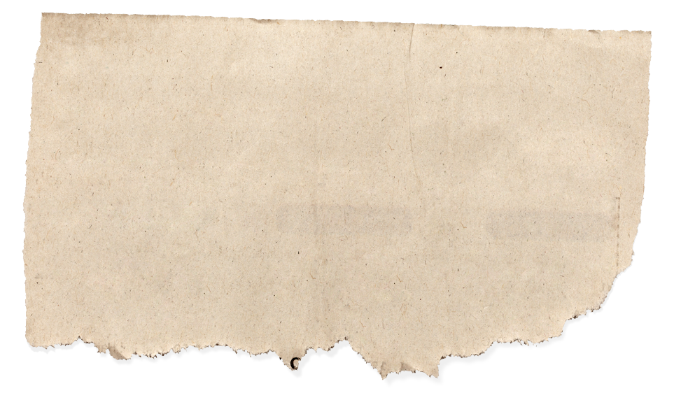







Product presentation
TITLE:
BLACKSAD: Under The Skin
PLATFORMS:
GENRE:
ADVENTURE - NARRATIVE
RELEASE:
September 26th 2019
SRP:
Limited Edition 49,99€
Limited PC / MAC 39,99€
Collector Edition 119,99€
AUDIO
DEVELOPER:
Pendulo Studios / YS Interactive
TEXTS
PUBLISHER:
Microïds

Slide 3

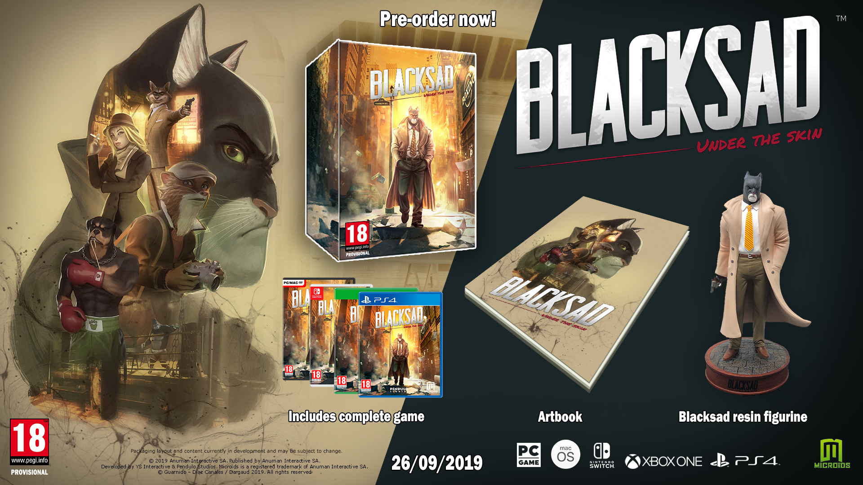
Collector Edition

Slide 4







Benchmark
L.A. NOIRE
HEAVY RAIN
Devil’sDaughter
The Wolf Among Us
Release date
May 2011 & May 2017
Sales
+7,5M Units
Release date
February 2010
Sales
+3,25M Units
Release date
June 2016
Sales
+140K Units
Release date
October 2013
Sales
+1,5M Units
Source: VGChartz

Slide 5
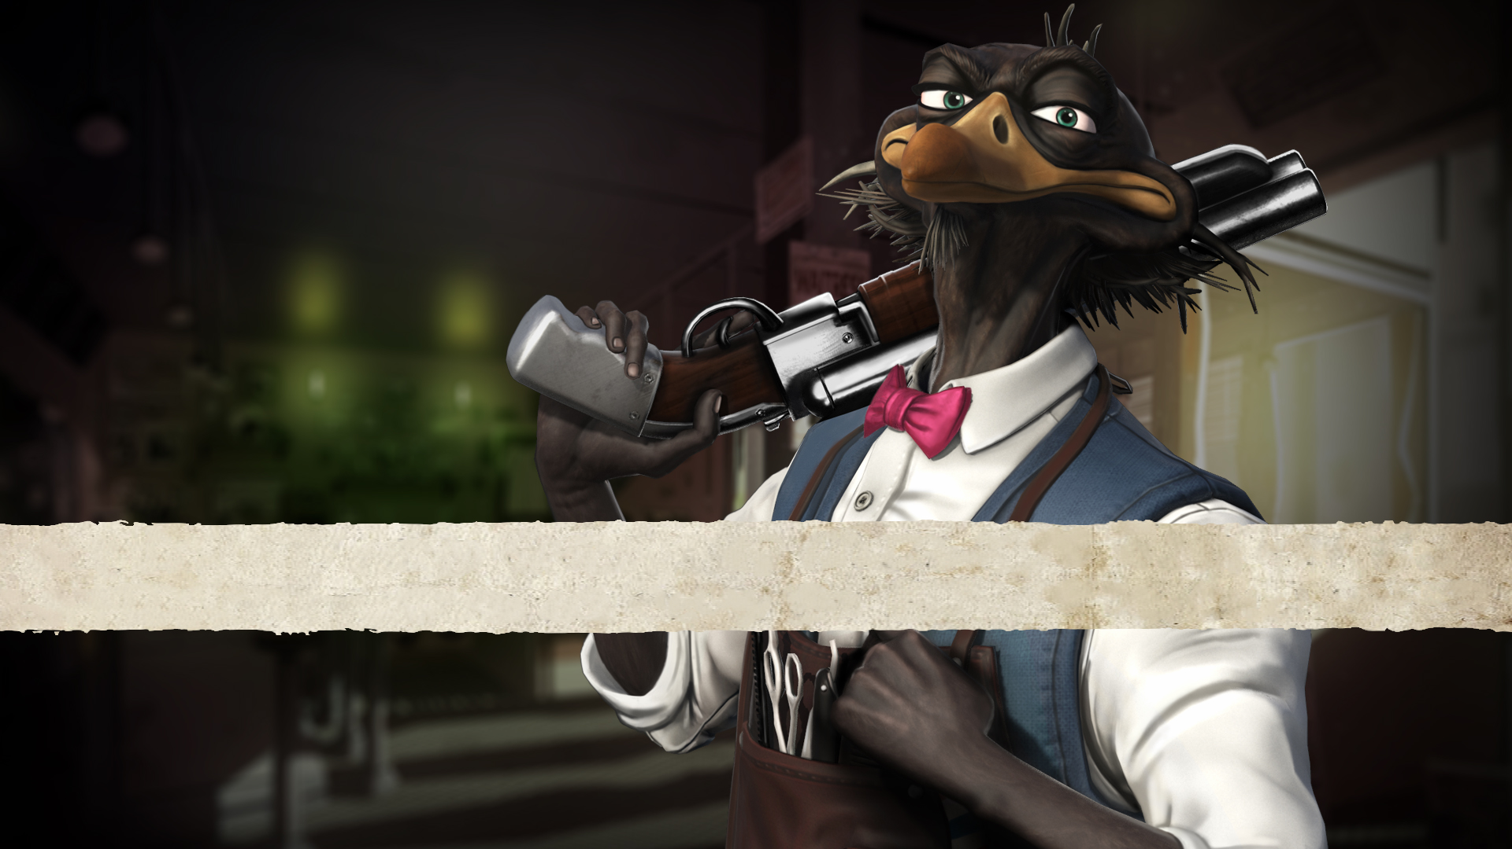
MARKETING PLAN 2019

Slide 6

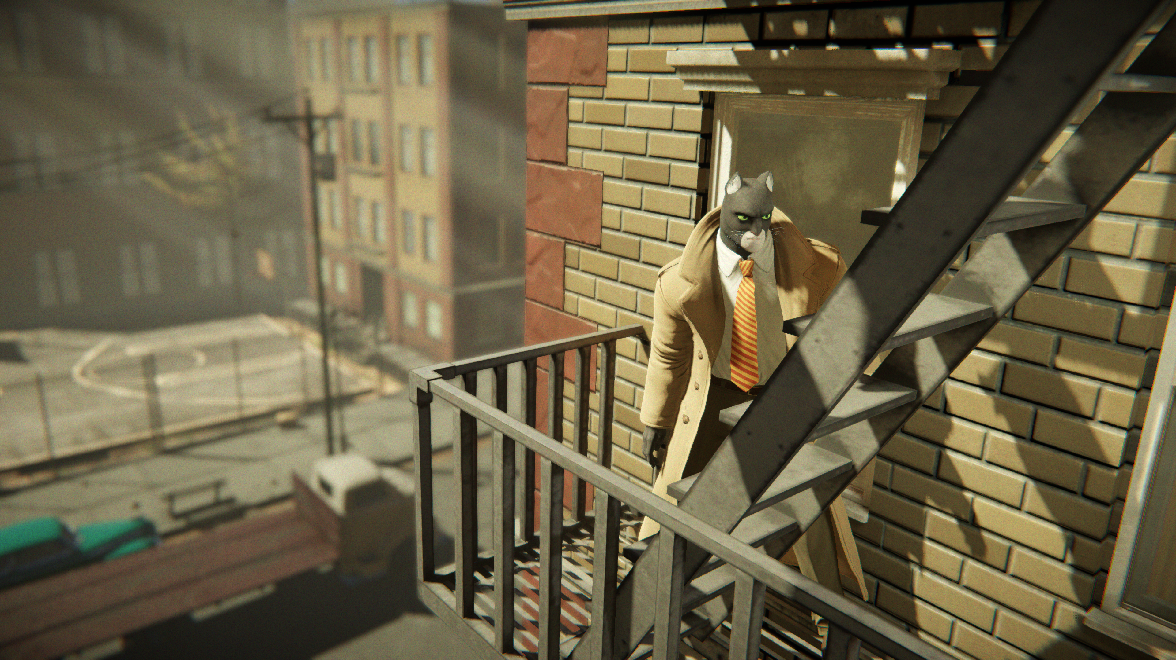
Positionning
the most anticipated Adventure game of 2019 With a Strong lead Character in a NOIR & mature atmosphere set in a unique Anthropomorphic world
KEYWORDS:
BLACKSAD
Detective
Investigation
Adventure
Narrative
POLAR
NOIR
NEW YORK

Slide 7




Preorder Rewards
Pins (x3)
Coasters
DRESS UP TIE
Flip notebook

Slide 8
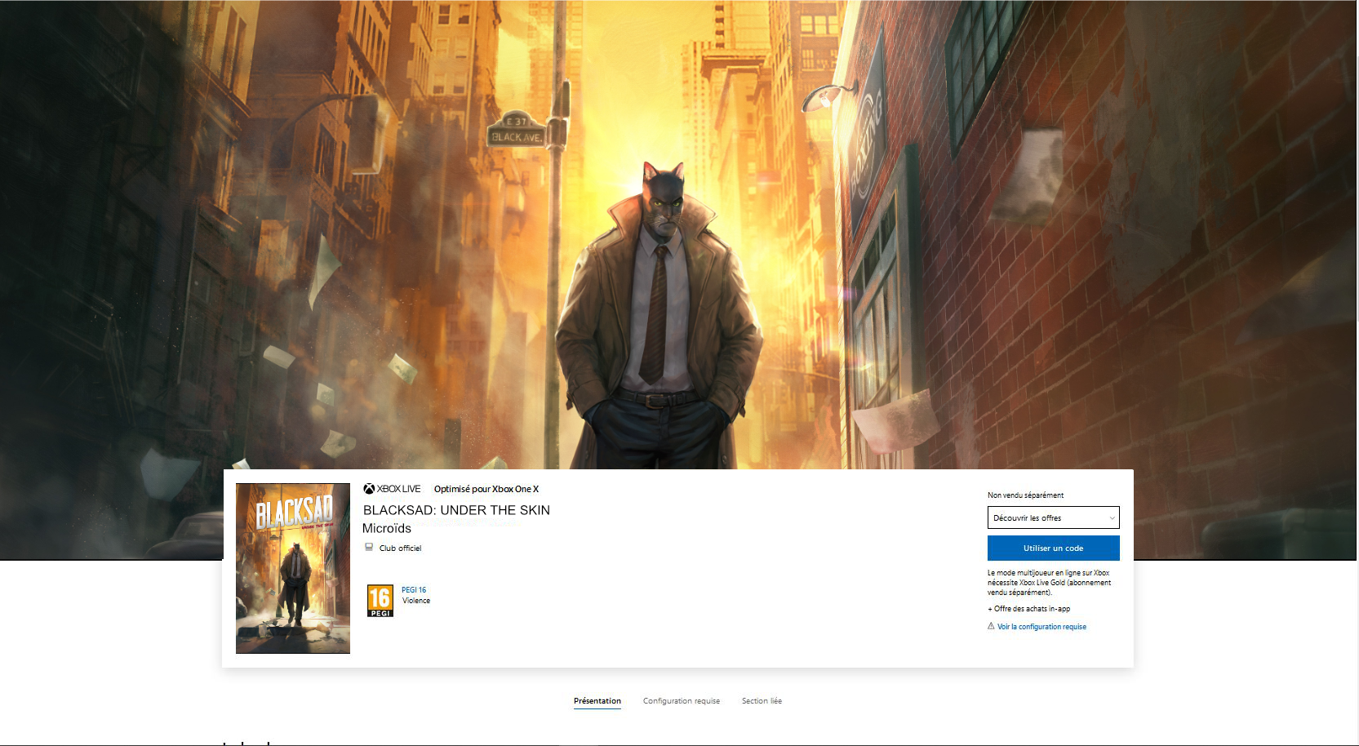



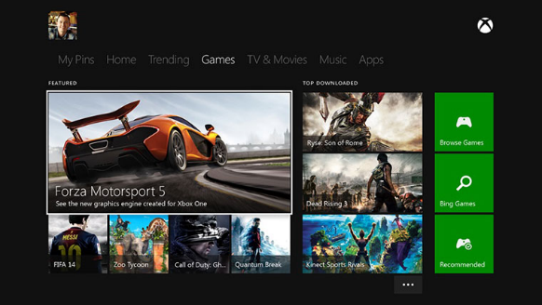
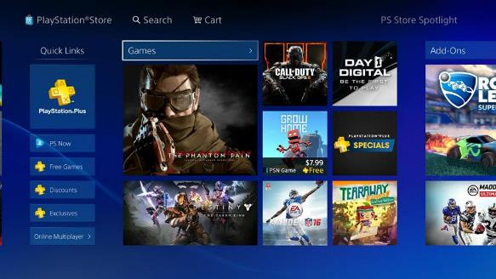

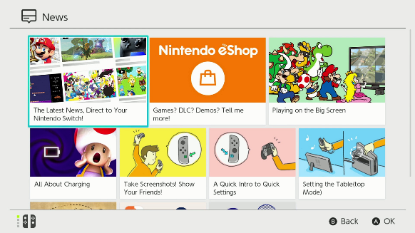
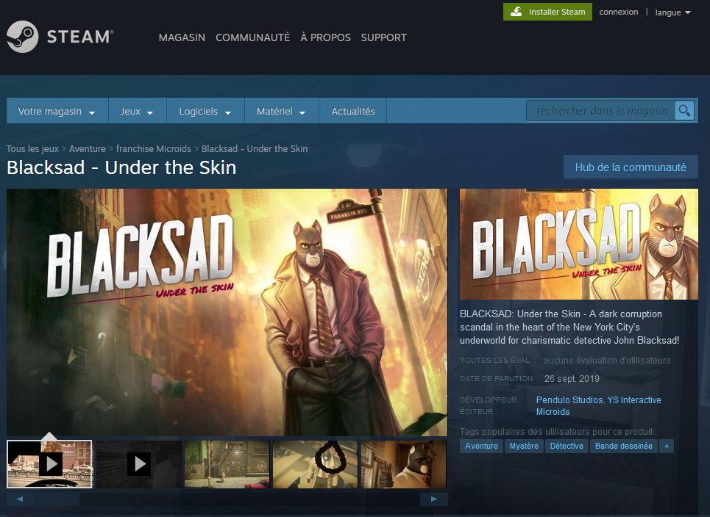
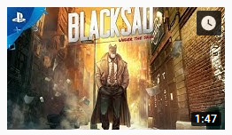
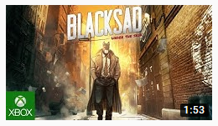

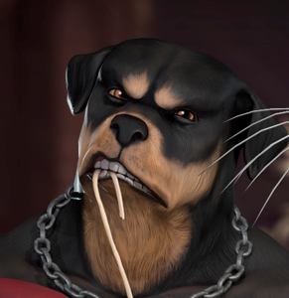
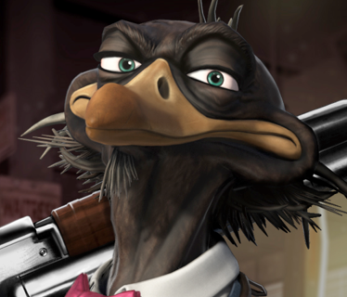
First Parties Partnerships
Dedicated game pages
Digital ad on First parties digital stores
Content sharing on first parties Social Networks (Youtube / Facebook / Twitter…)
THEMES, BACKGROUNDS & AVATARS for PS4 & XBOX ONE

Slide 9

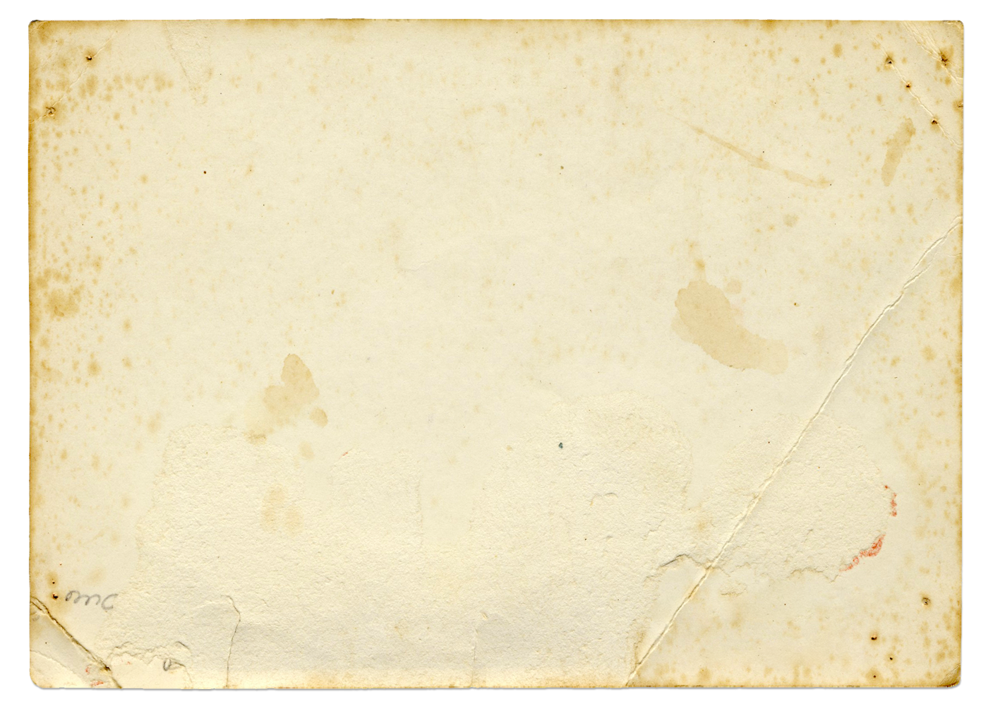




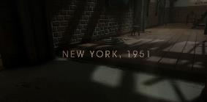

Digital Media Campaign
Raise awareness with qualitive ad campaigns:
Facebook ad campaigns (canvas, sponsored announcements, trailers)
2x30 sec videos
→ Targeting: General Gaming / Aventure game
Comic books / Pop Culture
Sponsored AD campaigns featuring 30 sec spots with call to action
30 sec advertising spots targeting gaming related content

Slide 10

Marketing Actions
LATE MARCH
MAY
SEPTEMBER
Press release announcing realease date
+
New screenshots
Sponsored Twitch streams
+
Youtube content
Retail/Steam preorders listing
+
Additional content (OST, comics…)
SEPTEMBER
LATE APRIL
LATE JUNE
Playable DEMO + Possible EARLY ACCESS for players who already preordered
Story Trailer release +
collector edition announcement
+
support from Sony & Microsoft on the trailer
Reveal additional preorder content on PS4 & Xbox ONE + open preorders on PS4 / Xbox ONE

Slide 11
Trailer / Video strategy
ALREADY PUBLISHED
ALREADY PUBLISHED
AUGUST 2018
Introducing Blacksad as the main character
EARLY JUNE
From comics to video game
Discuss adaptation project genesis
Work between the authors and development teams
AUGUST
(GAMESCOM)
Game mechanics reviewed
APRIL
Blacksad going back on the investigation
Introduction of a few characters
GAMESCOM 2018 TEASER
Story TRAILER
Making of part 1
TRAILER 2 - GAMEPLAY
EARLY SEPTEMBER
Interviews with pendulo
Going back on what challenges they faced, how they overcame them
What was new for the studio MOCAP rush with gameplay parallel
MID SEPTEMBER
UNBOXING by Pendulo or the authors
MID SEPTEMBER
Content tbc
MAKING OF PART 2
Unboxing Collector
Launch Trailer

Slide 12

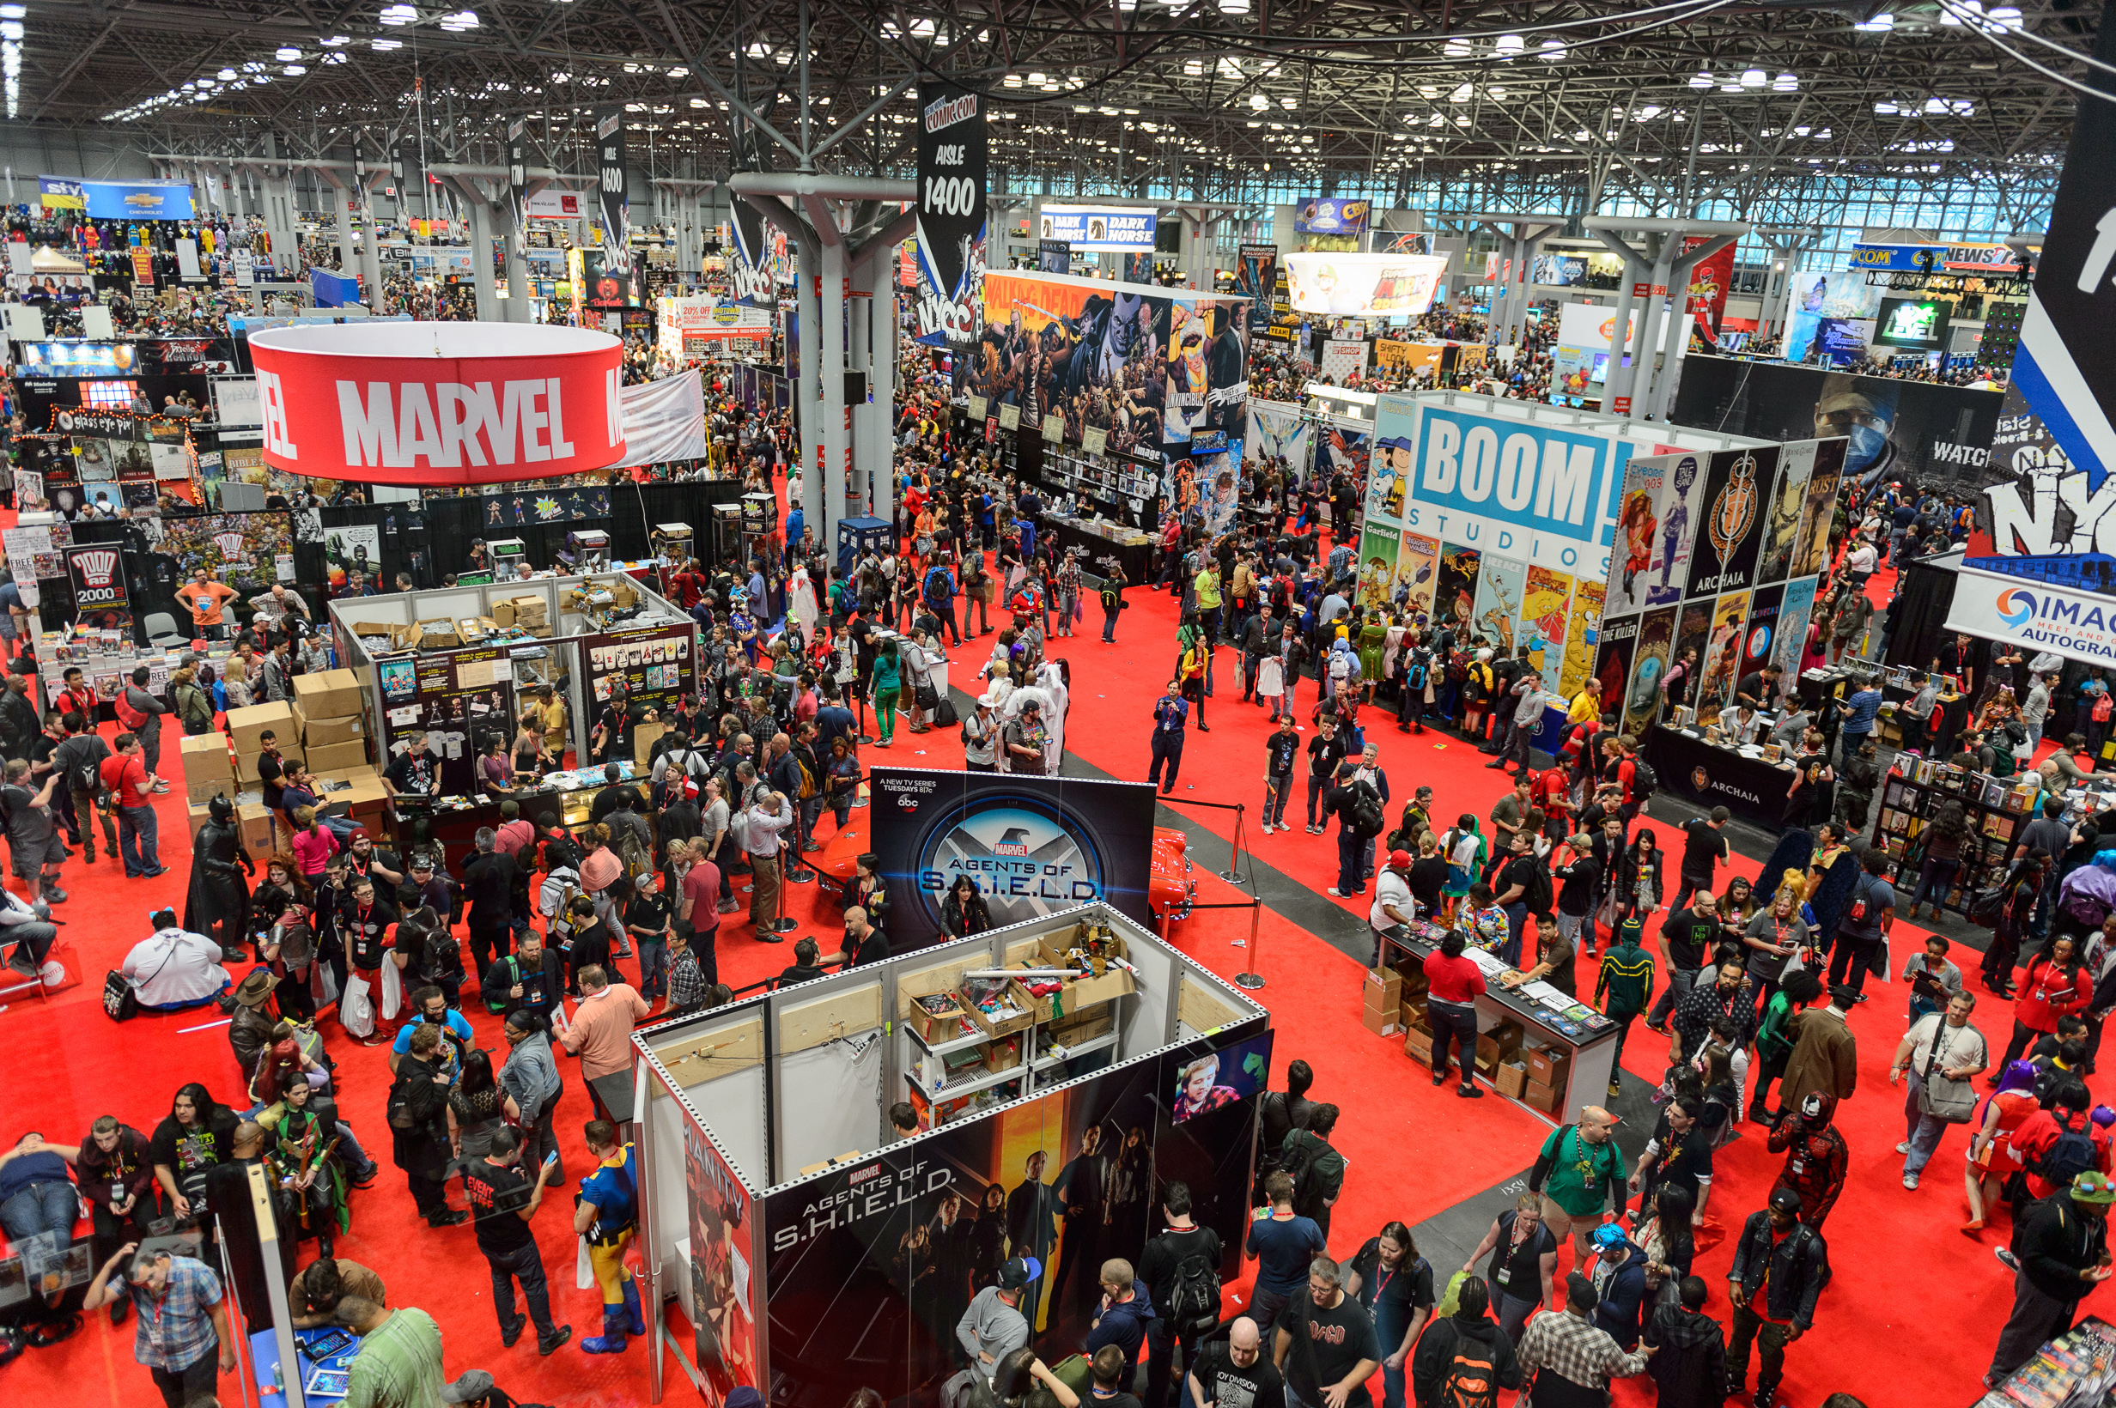
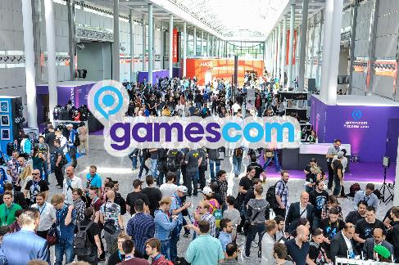

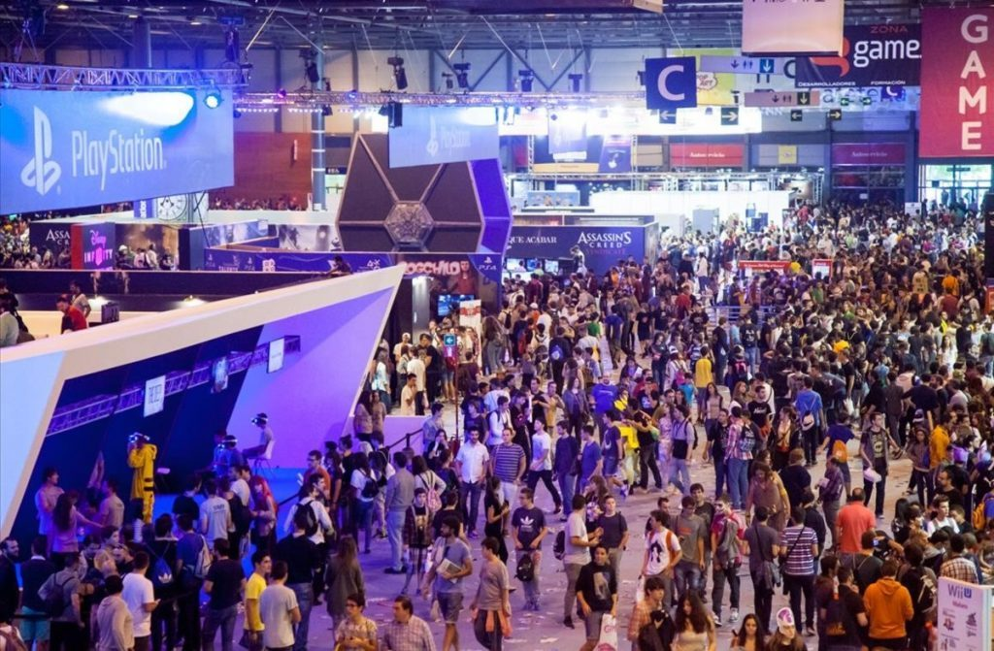


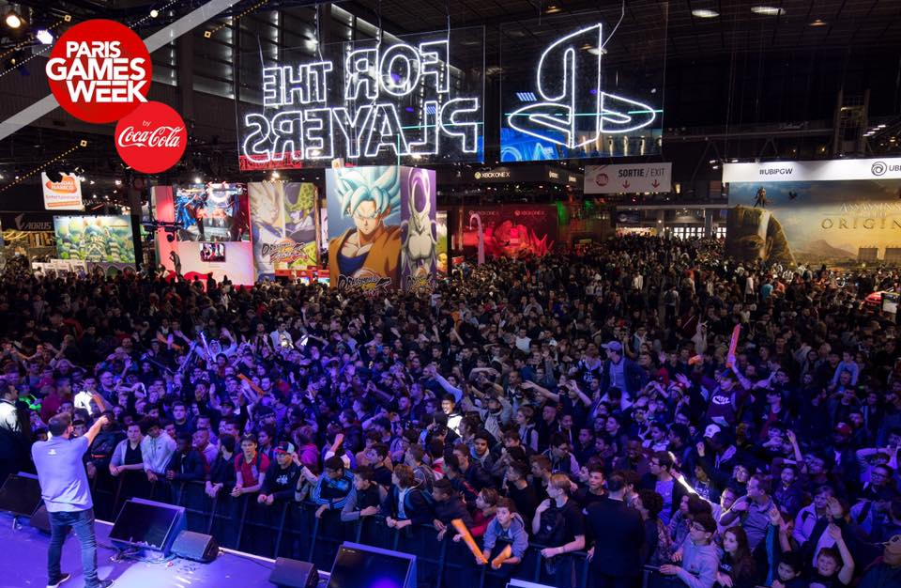
Events & fairs
350 000+ visitors
30 700+ trade visitors
1st european’s business gaming platform
Playable demo on mainstream Sony or Microsoft booth
OCTOBER 2019
Be present at one of largest comic fair to maximise visibility – at launch
Reach a comic enthusiast audience that may or may not know about blacksad
Set up Blacksad as a strong crossmedia franchise
AUGUST 2019
43,000 square meters of exhibition
Average of 100K visitors / fair
Especially interresting for Blacksad as Spain is a key territory
304 000+ Visitors in 2017
Biggest Video Game exhibition in France
Goodies giveaway
Playable demos
BLACKSAD art corner
OCTOBER 2019
OCT/NOV 2019

Slide 13
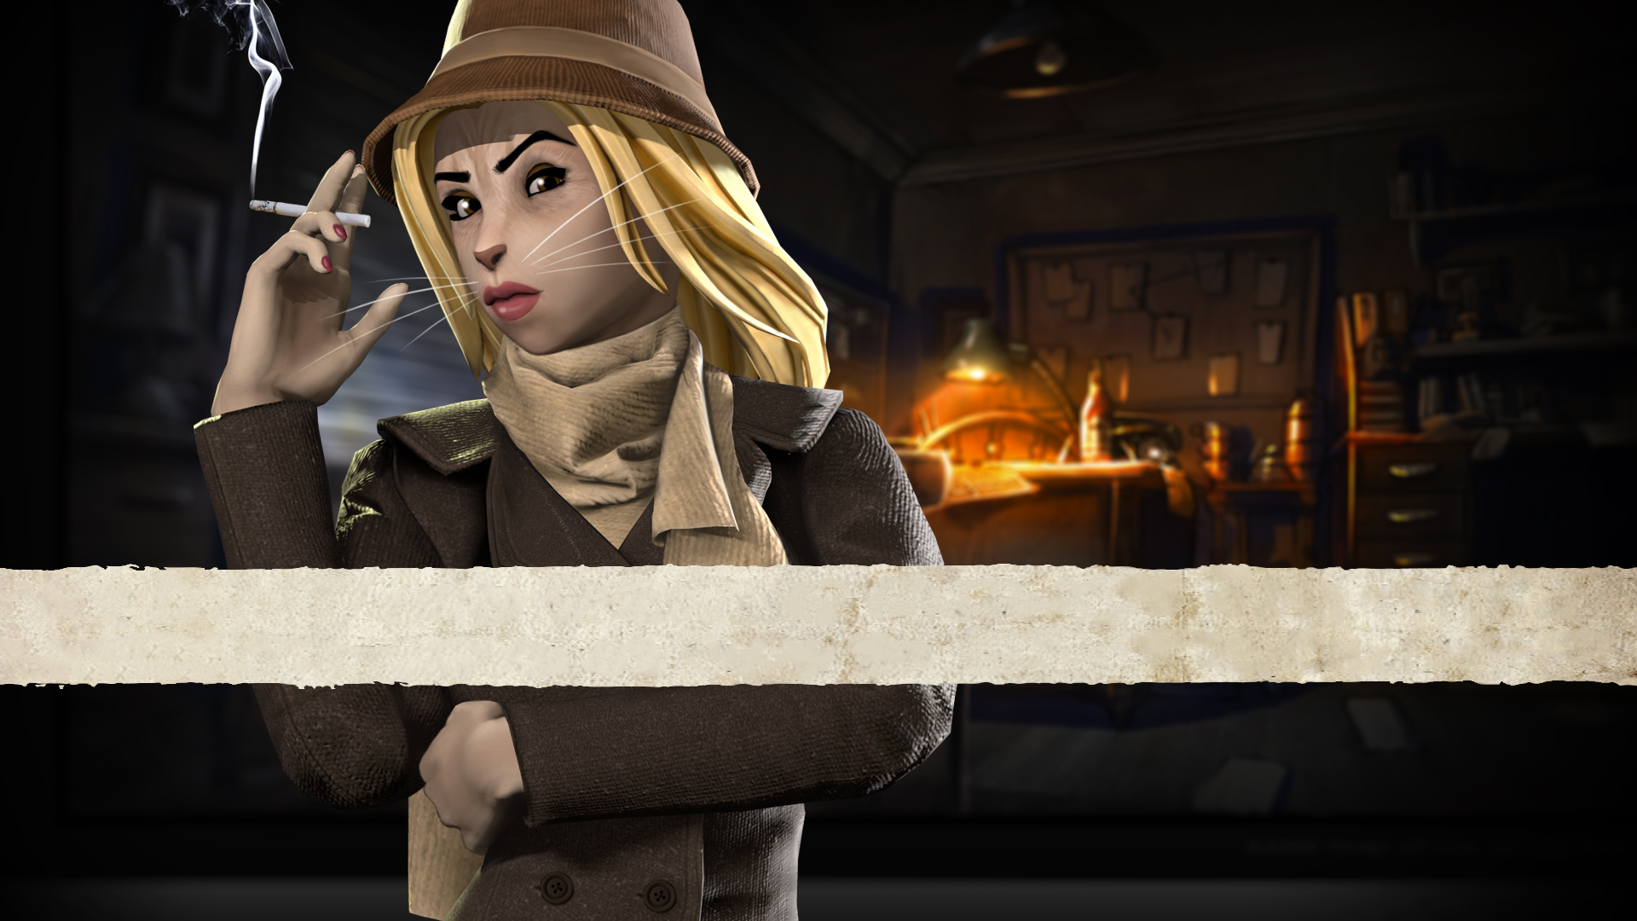
PR PLAN

Slide 14

PR Strategy
Use press events to share the unique universe and offer overviews of the game
Leverage key gaming industry events and comic book events to drive awareness
Explain the collaboration between Pendulo Studio and the authors: the game is faithful to the comic book universe
Organize Interviews to explain concepts and inspirations (Pendulo Studios, J. Guarnido & J. D. Canales)
Focus on the original story, arts (artistic direction and music)
Reveal progressively Blacksad’s universe thanks to PR and social media initiatives.
POSITION BLACKSAD AS THE BEST ADVENTURE GAME OF THE YEAR AND AS A REFERENCE OF NARRATIVE-ADVENTURE GAME

Slide 15
Targeted Media
Specialized press (pre launch and launch coverage) both in print and digital range
Mainstream media (launch and sustain coverage) :
  Newspapers (Artistic side of the game)
  Comic book and movie magazines
  Entertainment
  Business
Influencers (lets play videos)
  Adventure specialized streamers + youtubers…

Slide 16
Events
US and European preview event :
Organize different preview events in different countries :
US : 1 day
France + Benelux + Netherland/Luxembourg + Italie + UK : 2 days
Germany : 1 day
A special build to show the game to journalists (hands-on event)
Dedicated press folder and goodies + decoration (roller banner,…)
Guests to answer the questions and take care of the interviews
Gamescom :
Organize a last preview event during the show (lot-of international media present)
A special build to show the game to journalists (hands-on event)
A dedicated press room decorated in the universe of the game
A guest to answer the interviews

Slide 17
INFLUENCERS

Slide 18
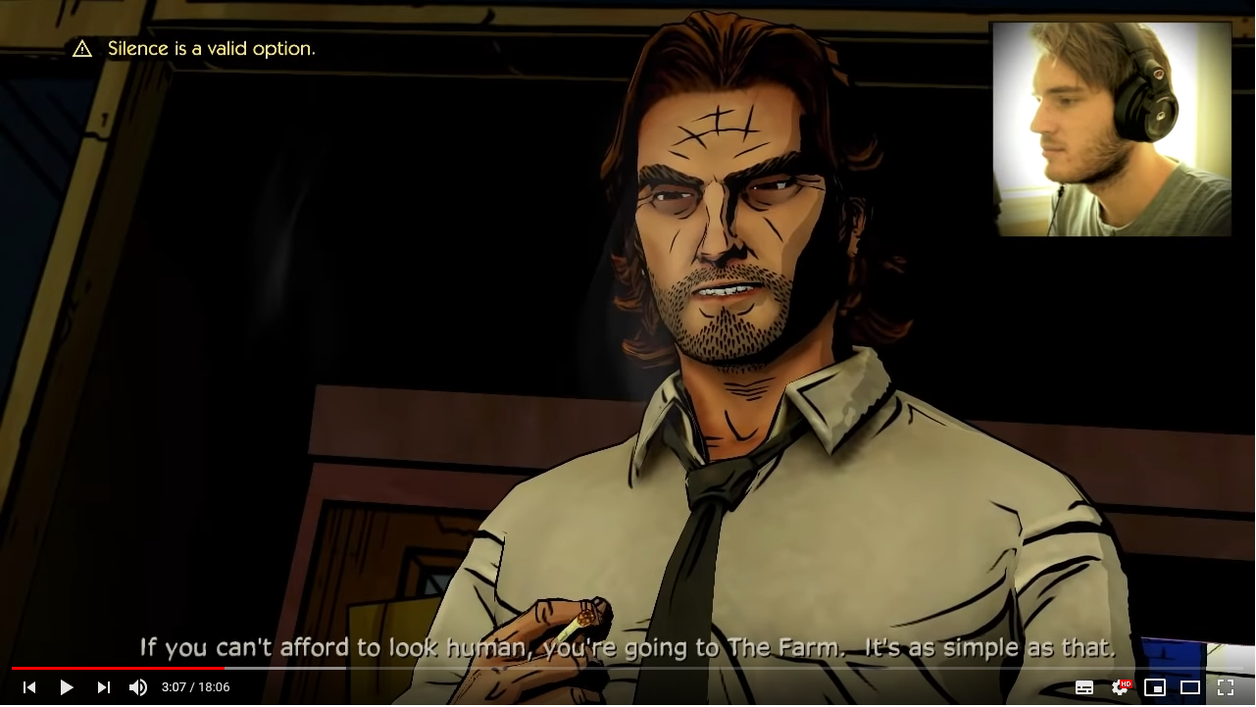
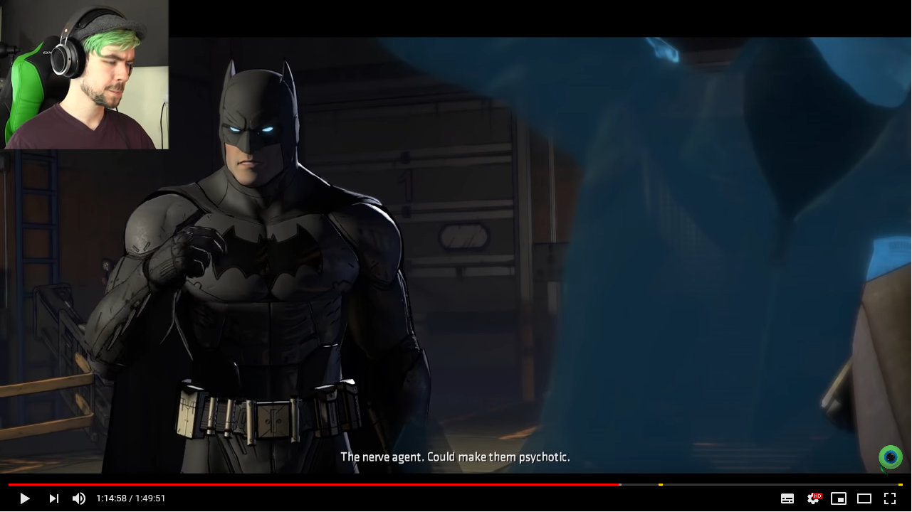
Influencers strategy
Let’s play video with gaming influencers
Create specific content with influencers who have a super strong fan base within our demographic target to :
  Immerse audience into the world of Blacksad before the game’s release
  Wider our audience
Work with streamers to secure Day One live stream on Twitch

Slide 19
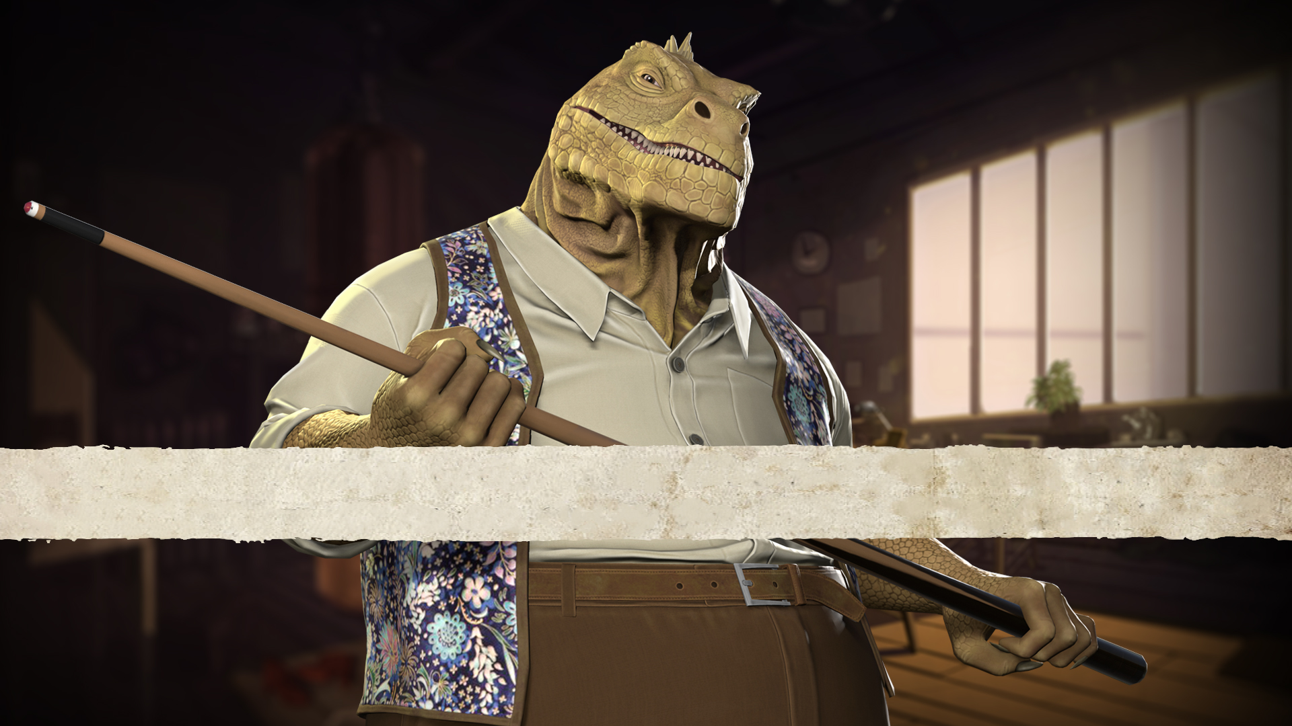
SOCIAL MEDIA PLAN

Slide 20

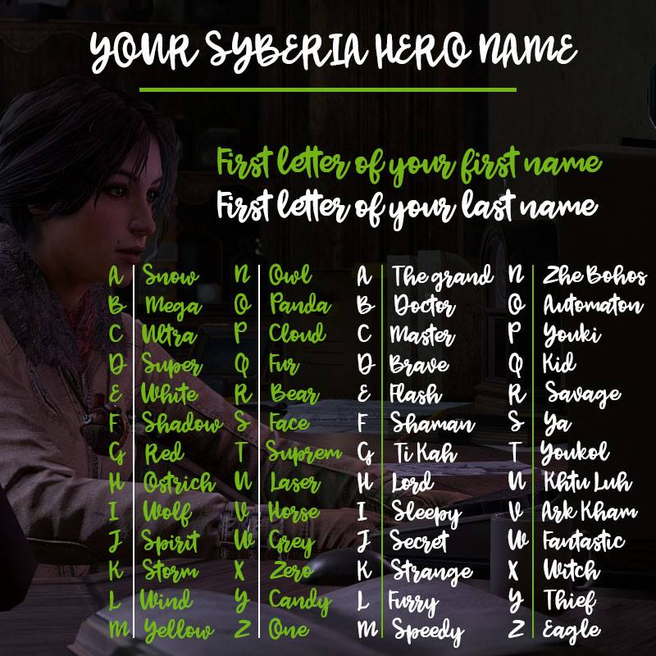
Facebook initiatives
What Blacksad are you? – 1 time
Mini investigation scenario - 1/month
Profile photo filter
Your investigator's name - 1 time
Blacksad: collection of evidence – 1-2/month
Video spots based on real cats VS Blacksad
Story game fans
Blacskad fans
Adventure game fans

Slide 21

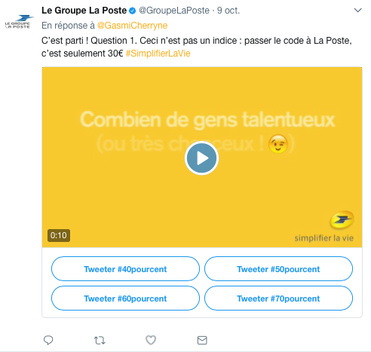

Twitter initiatives
Investigation game with these elements that are dispatched (release date)
A quiz system Twitter "Leads the investigation" (with agency) - 1 time
Your investigator's name - 1 time
Message hidden in an image (release date) - 1 time
Hidden Blacksad object in real life - 1/month
What Blacksad are you? - 1 time
Mini investigation scenario - 1/month
Blacksad: collection of evidence – 1-2/month
Story game fans
Adventure game fans
BtoB

Slide 22

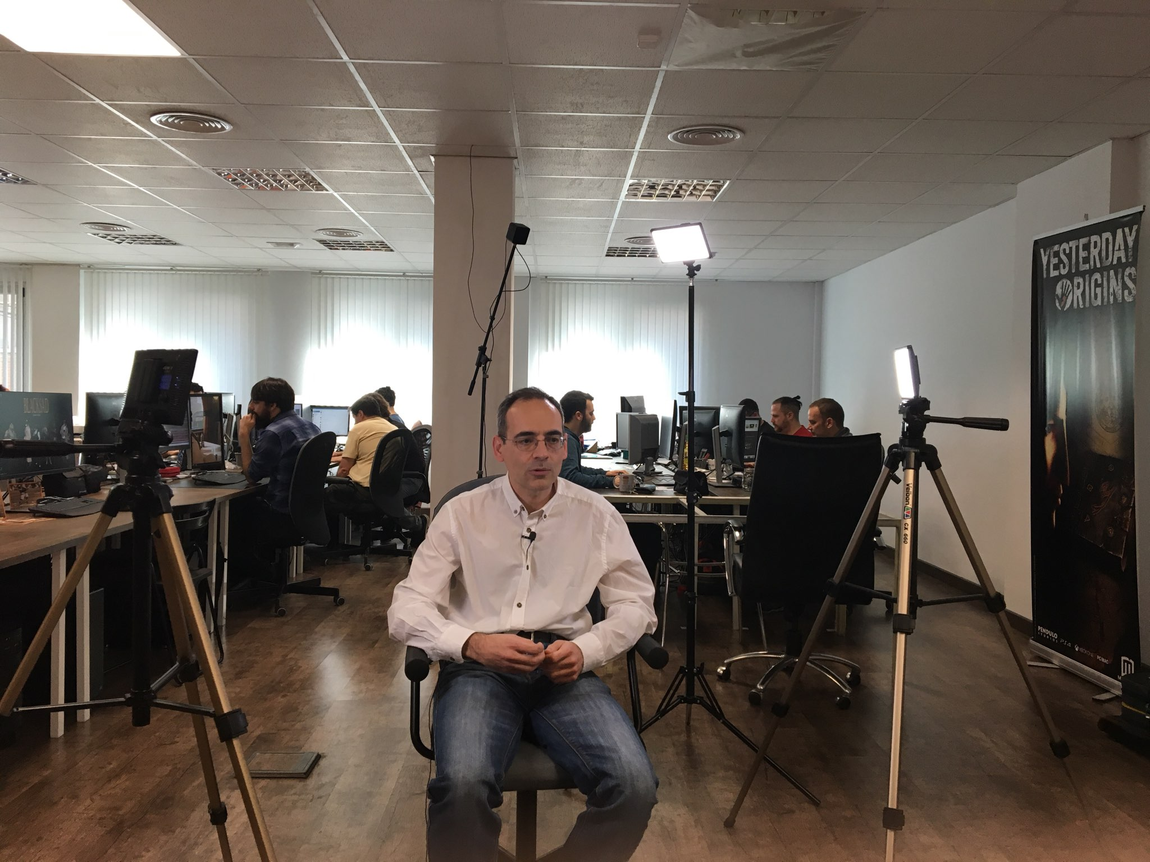
Instagram
Blacskad: Under the Skin
Creation of a dedicated account
Give more information about the game, behind the scenes…
Create exclusive content
Collection of evidence

Slide 23

Twitch
Blacskad: Under the Skin
Launch or prelaunch Twitch streams to raise preorders/orders
15 streamers from the main targeted countries
Explore the possibility of having some Blackad dotations for the streamers to give away

Slide 24

Schedule overview
JANUARY
FEBRUARY
MARCH
APRIL
MAY
JUNE
JULY
AUGUST
SEPTEMBER
MARKETING
Events / Fairs
Angoulême
E3
S.Diego Comicon
Gamescom 2019
Paris Games Week
Marketing highlights
Steam store page release
Announce date + new screenshots
PS4 / XONE preorders
DEMO
Collector preorder+ steam whishlist
Steam preorders
Trailers / Videos
Making of 1
Trailer 2 - Gameplay
Making of 2
Launch Trailer
Story Trailer
Unboxing Collector
COMMUNICATION
P.R
Preview event US
Review + press kits
Announce date + new screenshots
Preview event EUR
C.M
Instagram opening
Announce date + new screenshots
Announce Story Trailer
Keyart 2 revealed

