Slide 1
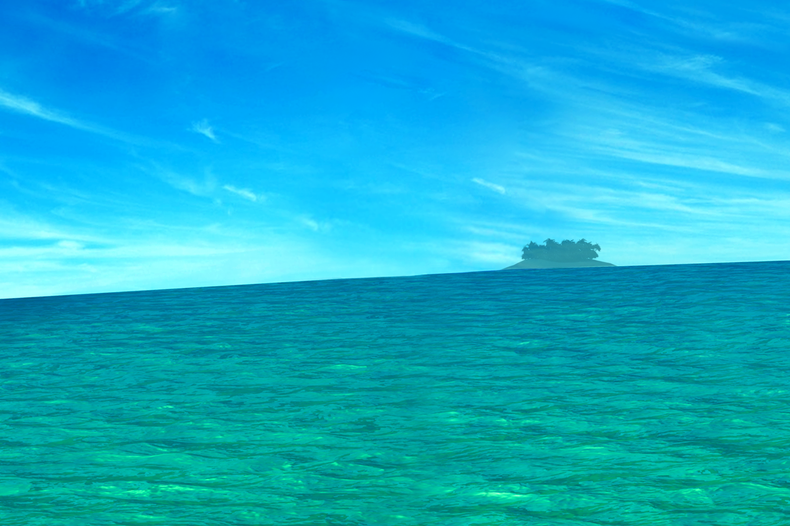
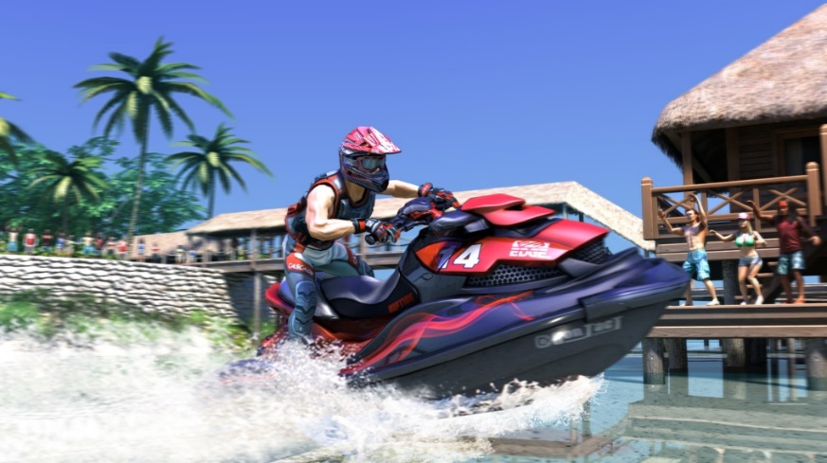
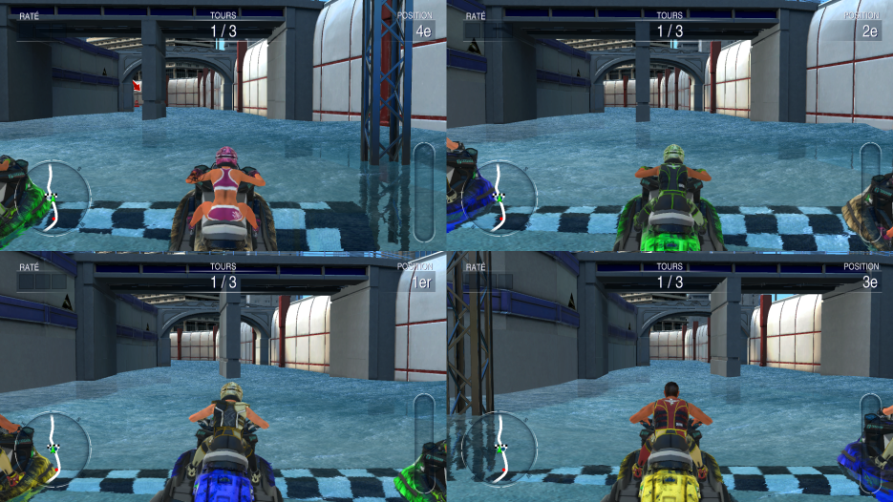
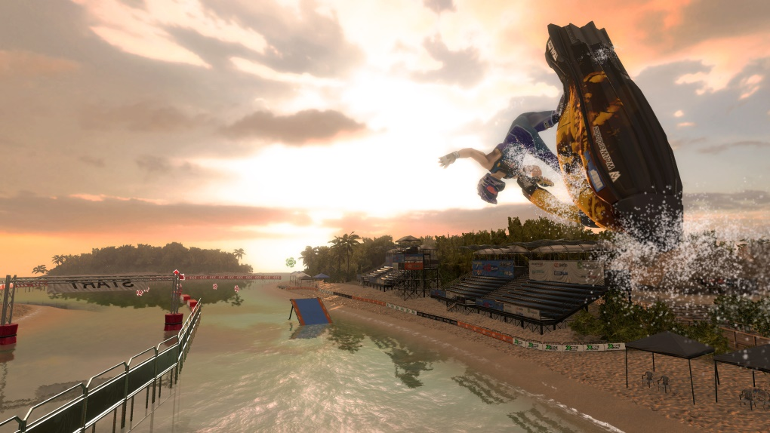
THE MOST EXCITING WATER RACING EXPERIENCE
Tons of tricks and stunts
Split screen up to 4 players.
10 environments
12 championships.
7 game modes.

