Slide 1



Publishing

Slide 2





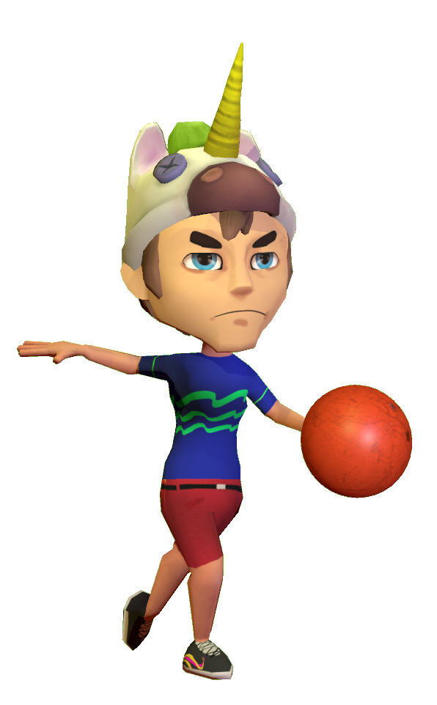




Instant Sports
Release date: 16th August 2019
• Nintendo Switch, Home of the party games ! Mario Party (5,5m° units), 1-2 Switch (Nintendo, 2,9m° units), Go Vacation (Nintendo, 370K units) Carnival (2K Games, 300K units), Sports Party (Ubisoft, 170K)… and now Instant Sports !
• Enjoy varied game modes through 6 different sports in local coop or versus with up to 8 players : Tennis, Bowling, Hurdles, Canoe race, Goal Keeper and Baseball !
• Easy to understand and handle (through motion control) so that every family member can have Instant Fun !
• Huge replayability to beat high scores and unlock loads of customization items
• Hardware :
• Genre : Party Game
• Studio/Publisher : Break-First / Just
For Games
• SRP : 29,99€ SWITCH

Slide 3
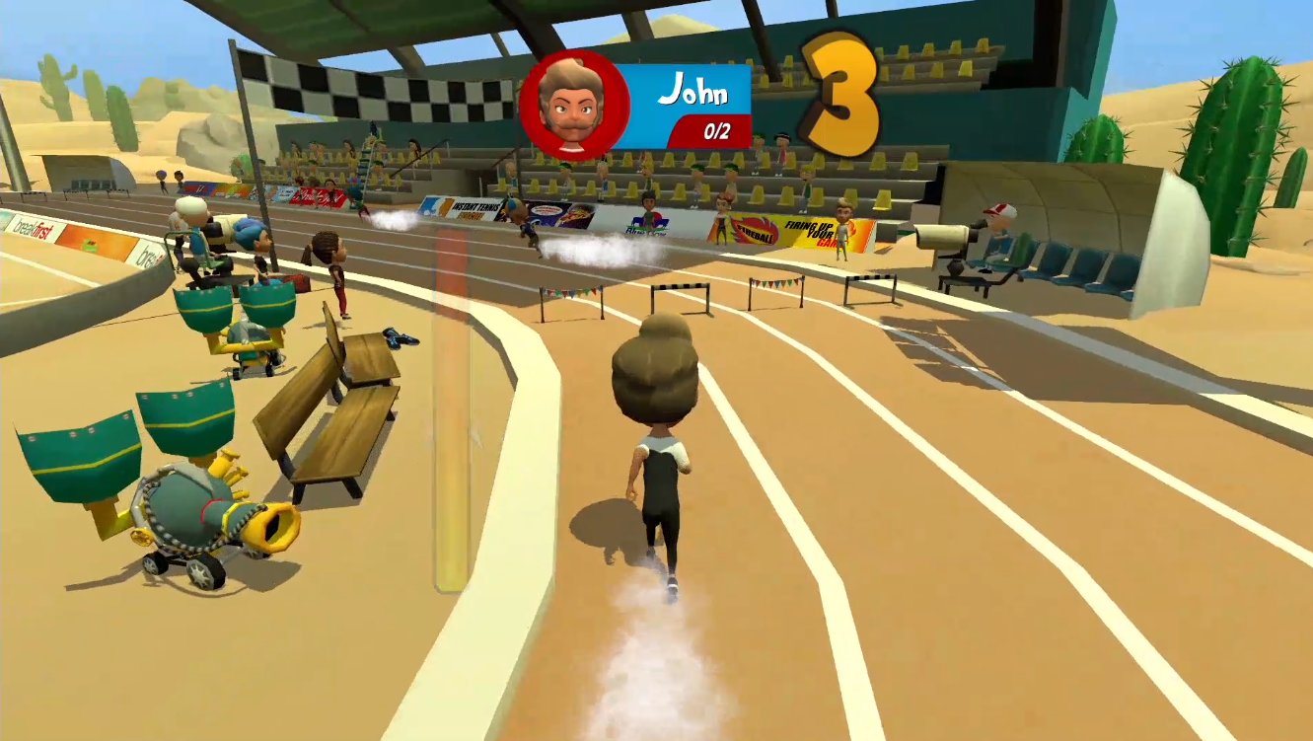
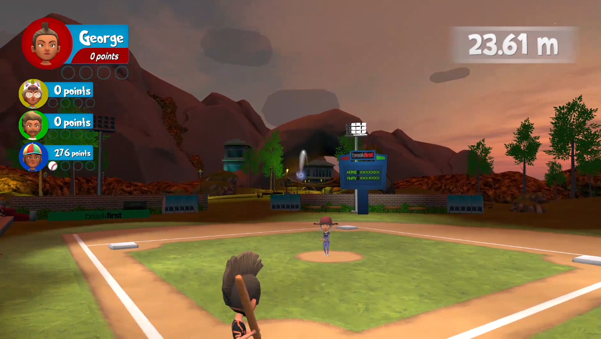
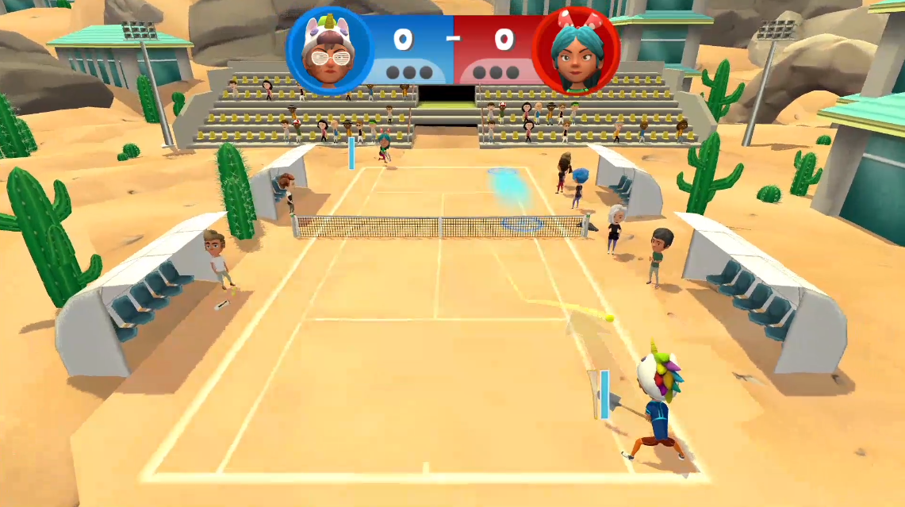
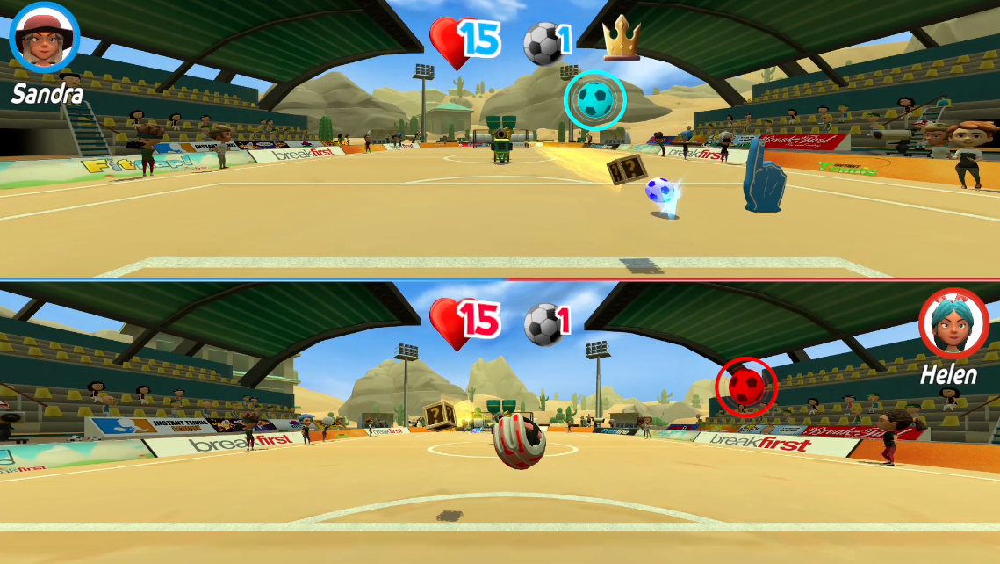
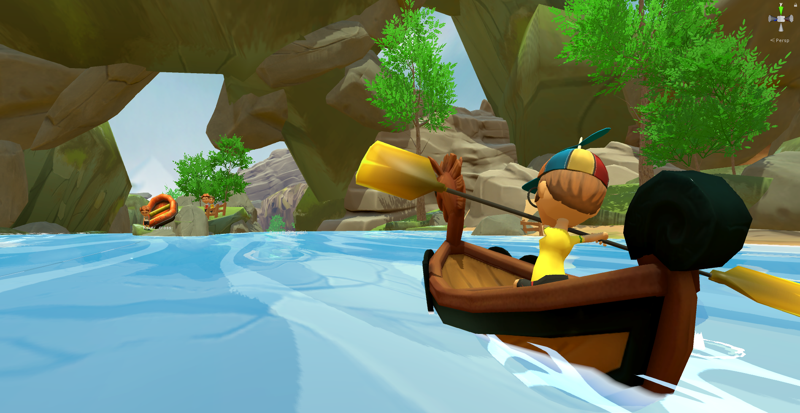
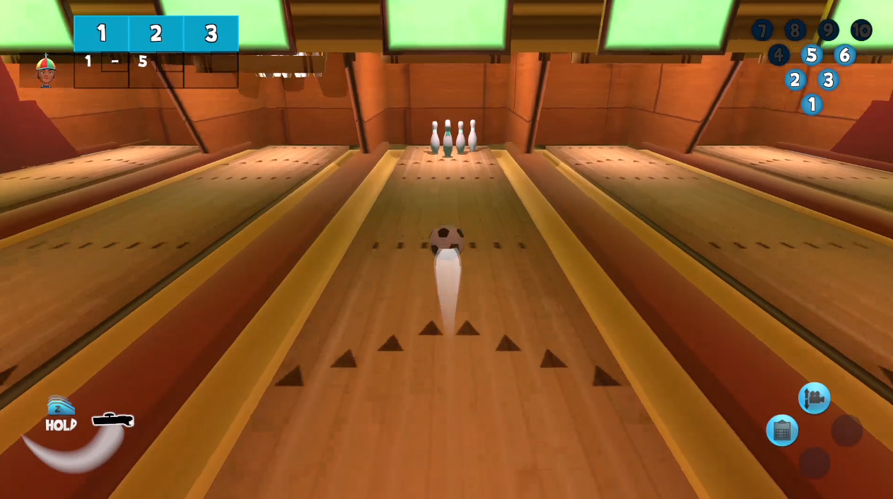
Race Hurdle
Baseball
Tennis
Goal Keeper
Canoe
Bowling

