Slide 1
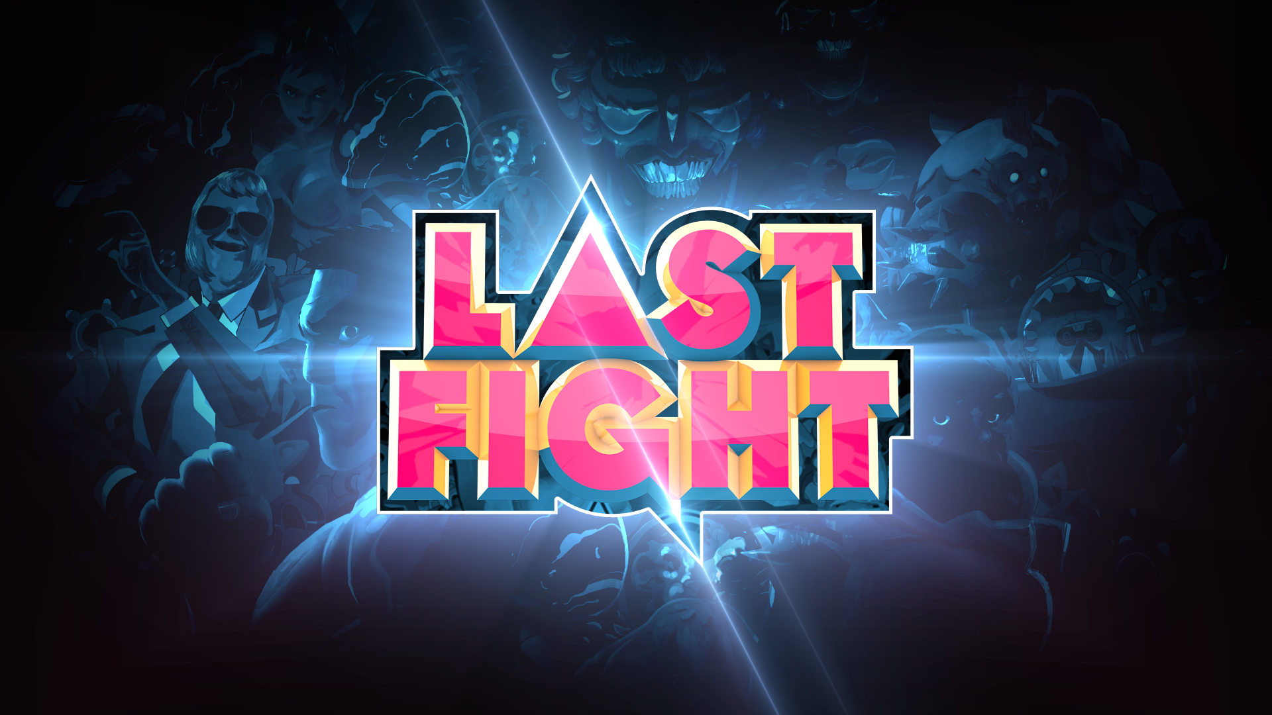


Sit, Relax & Fight!

Slide 2



Slide 3


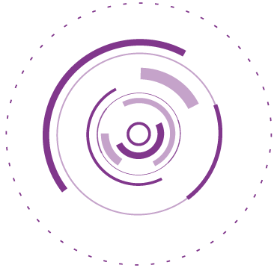
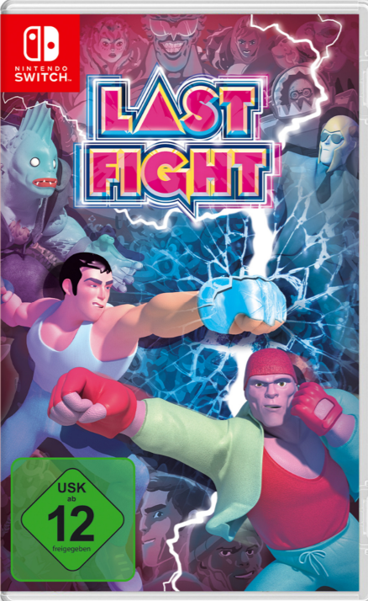
LASTFIGHT
Release date : 22nd November 2019
• Console :
• Genre : “Couch“ Fighting
• Studio/Publisher : Joindots / Just For Games
• SRP : 29,99 SWITCH
• Forecast (Eur / Aus-NZ) : 15 000
« LASTFIGHT is a fun brawler harking back to the good ole days of couch multiplayer. » - Playstation Country
Inspired by the famous manga and anime series LastMan (available on Netflix, rating 86%), LASTFIGHT is bringing 2v2 3D fighting back to your living room !
Pick up any available object in one of the 8 stages and teach your opponents a lesson in story mode !
Play in local multiplayer mode, for up to 4 players including a 2vs2 mode, with a cast of 10 characters inspired by the comic book Last Man.
LASTFIGHT is the perfect game to play with friends on your couch, reminiscent of the old fan-favourite “Powerstone” back in the Dreamcast days. Each level has specific bonuses and objects to hurl at your opponent. Will you manage to resist the temptation of the ANITRANS to win?
Provisional packaging

Slide 4




Slide 5















Some PS4/Xbox Reviews
75%
8/10
6/10
7/10
8/10
6/10
7/10
5,5/10
6,4/10
15/20
LastFight est indéniablement un jeu de combat réussi.
7,5/10

Slide 6
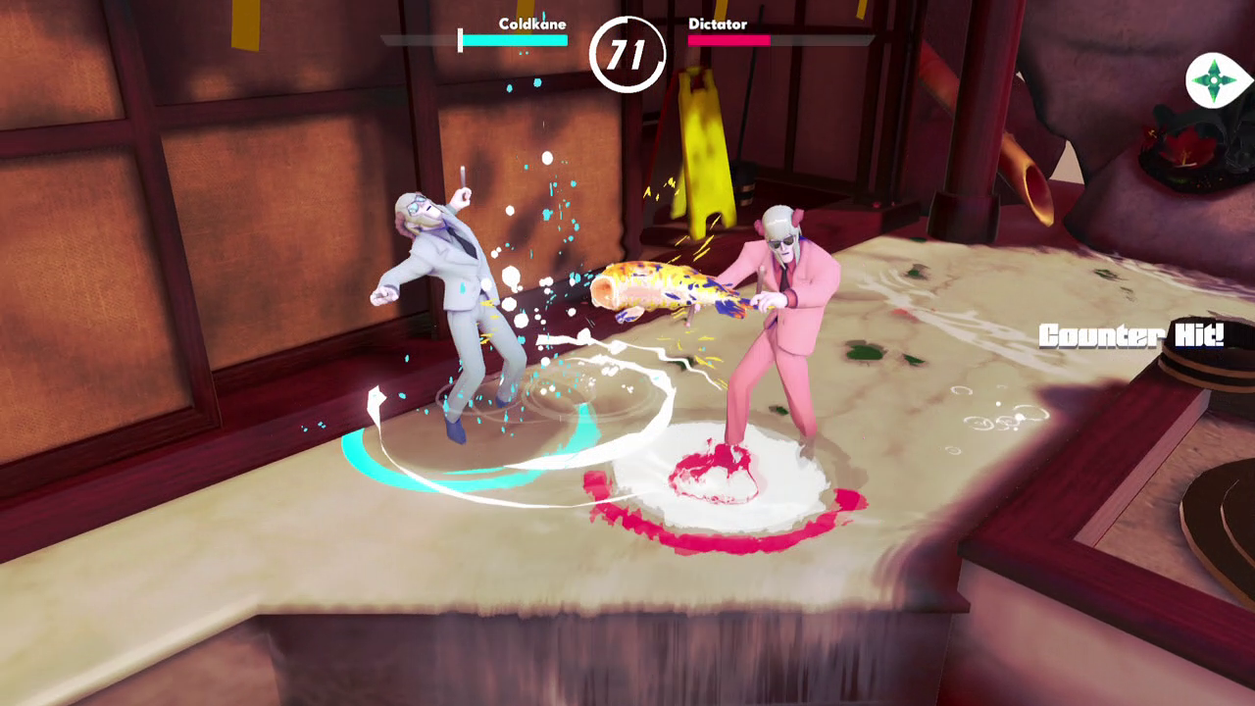
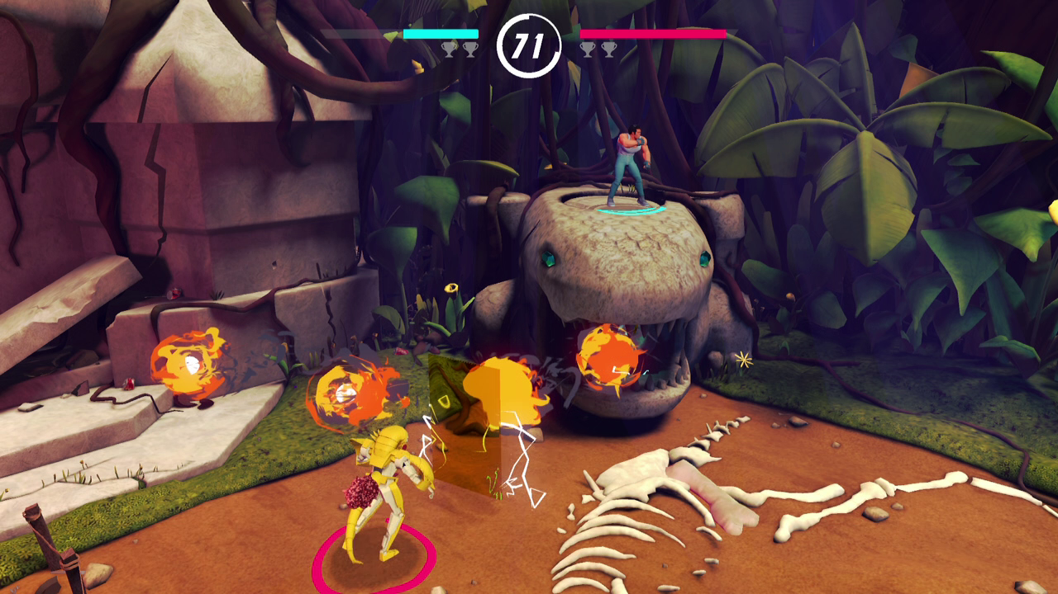
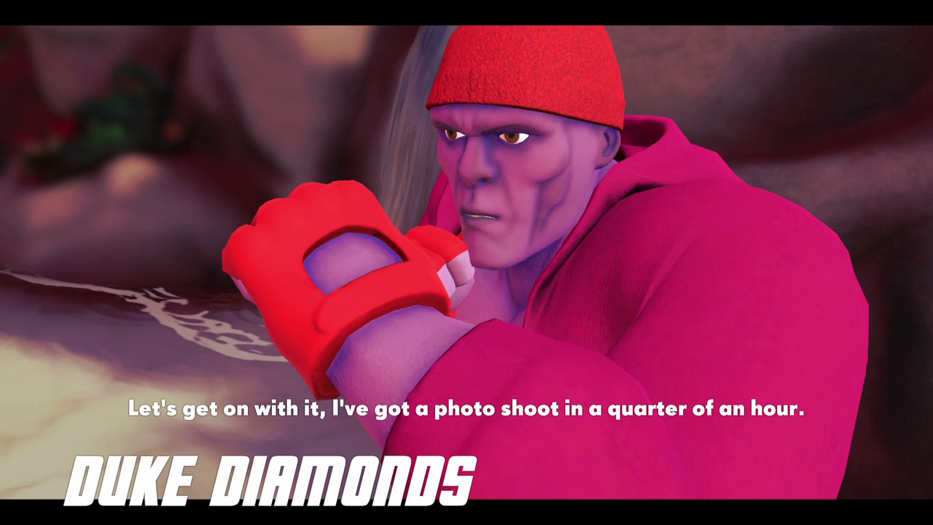
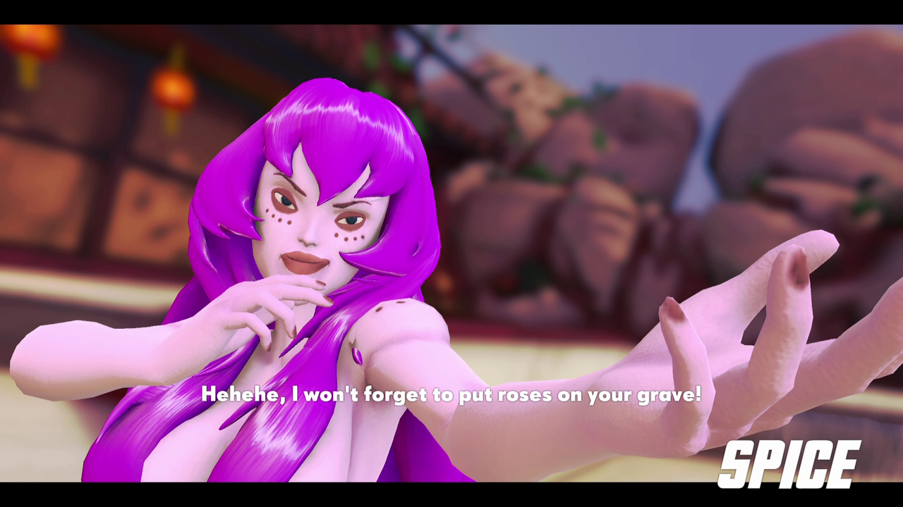
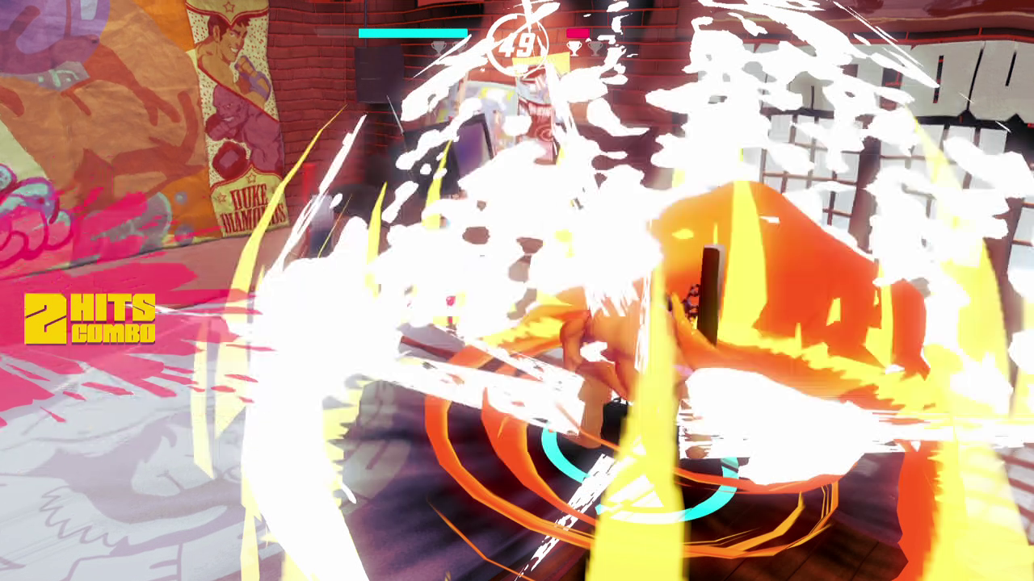

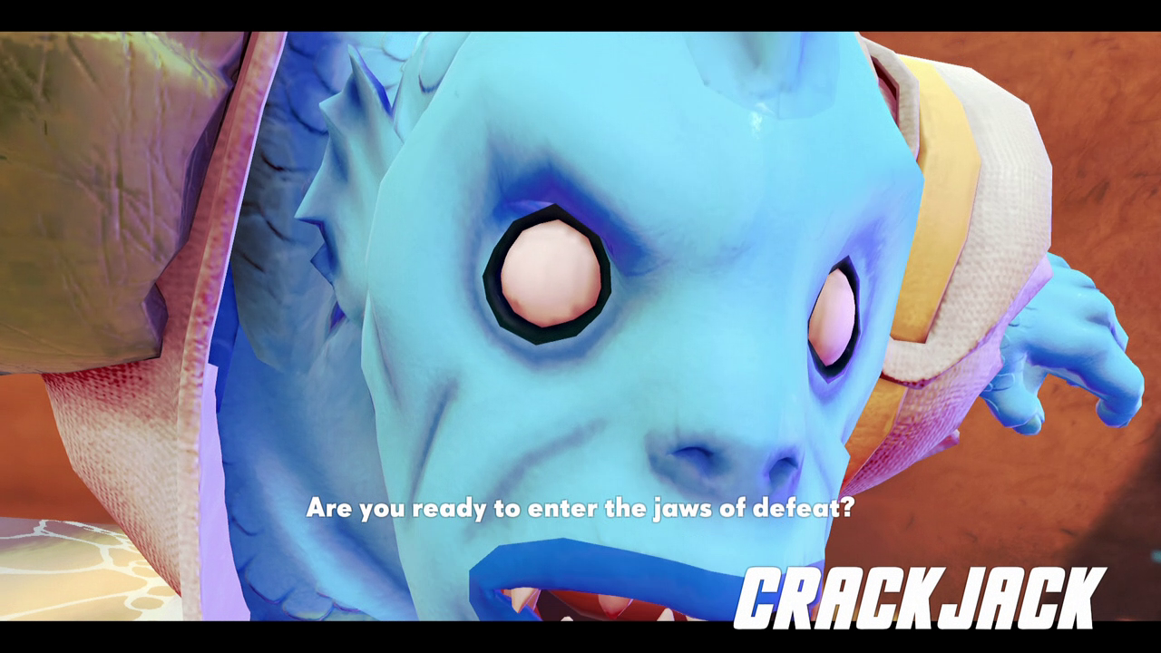
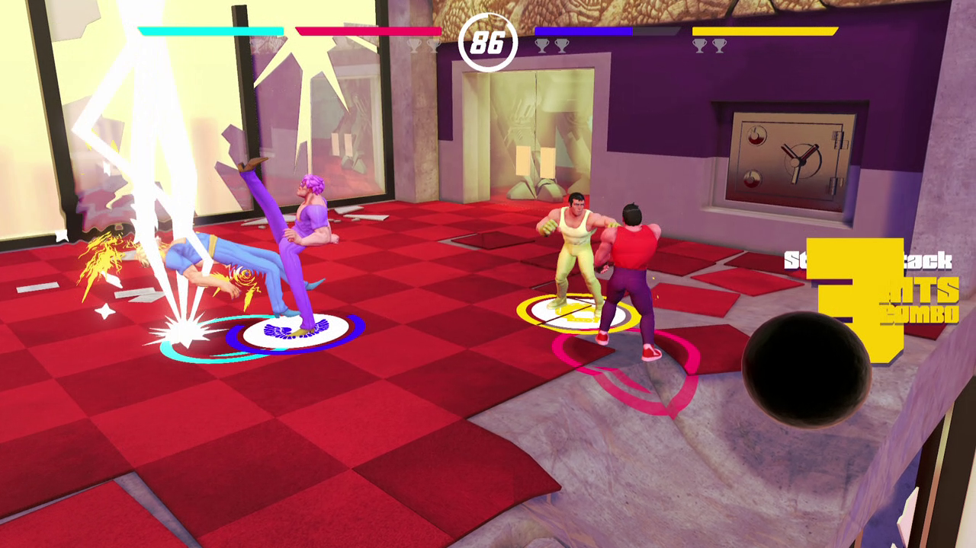

Slide 7

A quick overview of the franchise
which has inspired LastFight

Slide 8





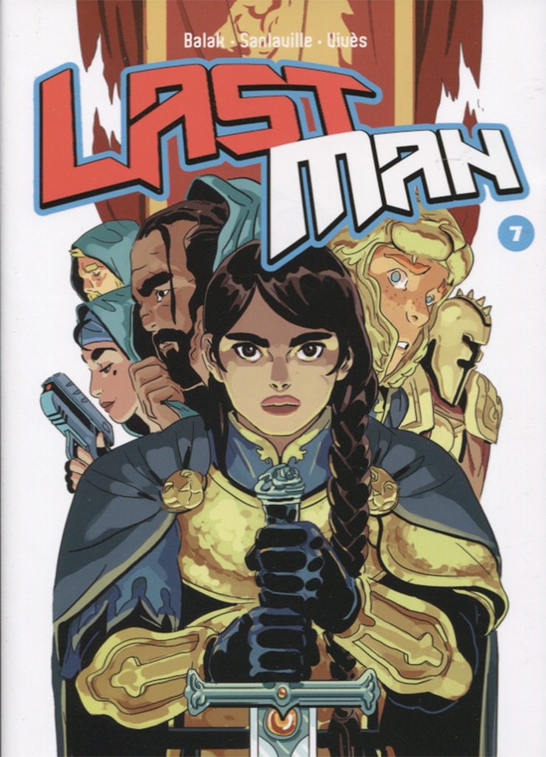



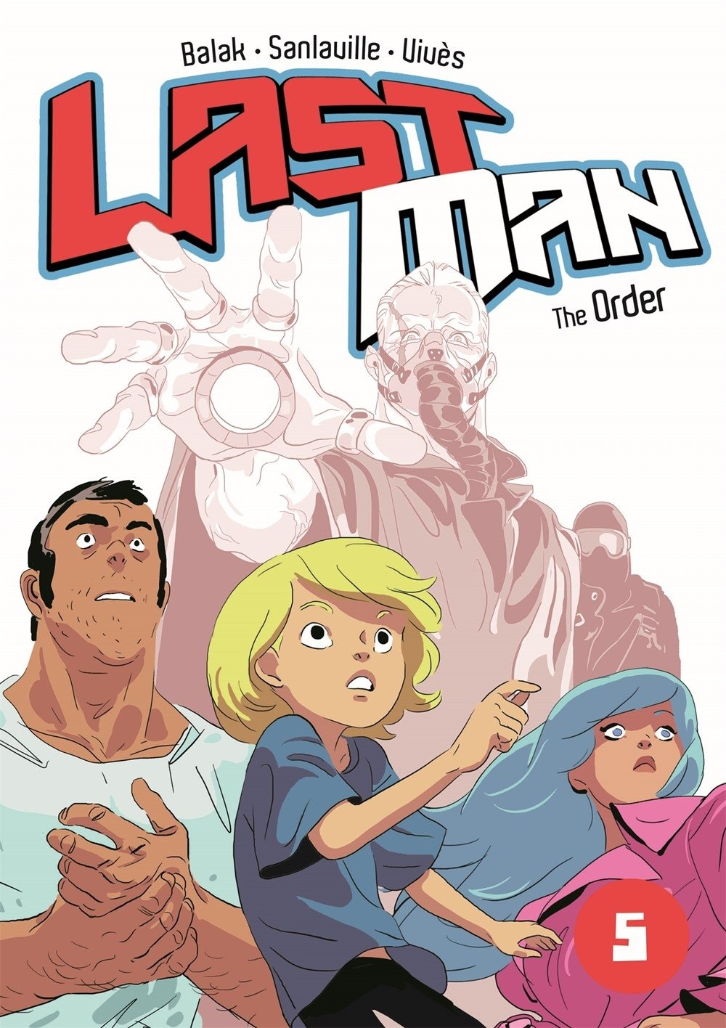
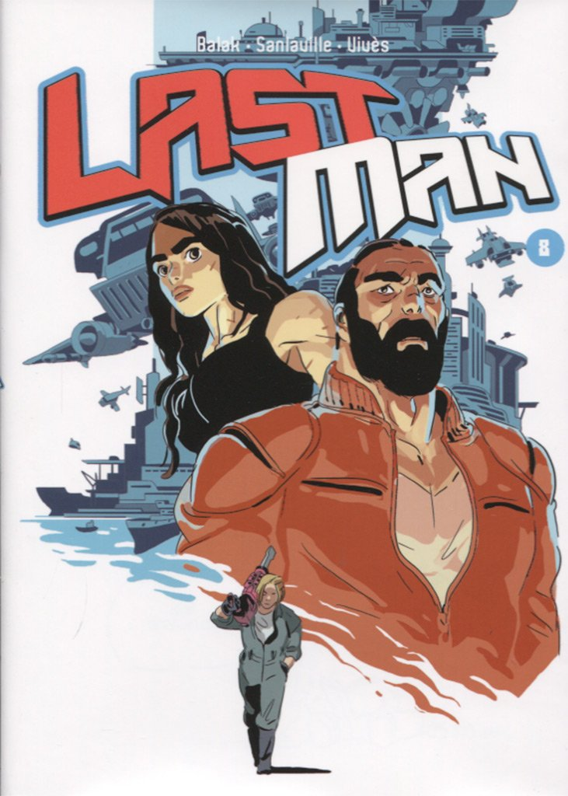
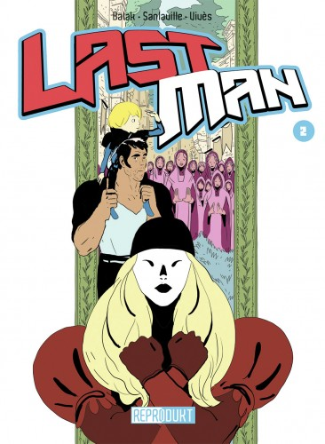

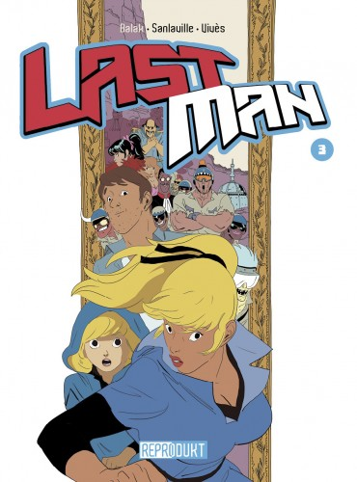


Slide 9


Slide 10
