Slide 1



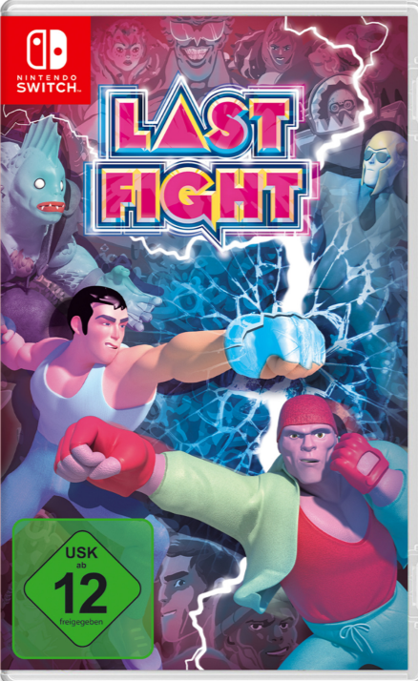
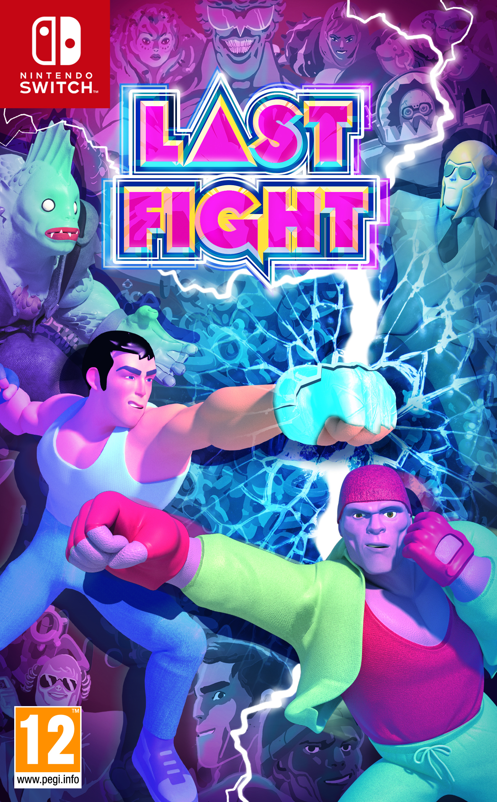
LASTFIGHT
Release date : 22 November 2019
• Console :
• Genre : Fighting 3D
• Studio/Publisher : Joindots / Just For Games
• SRP : 29,99€ TTC
• Forecast (EUR, AUS, NZ) : 15 000
« LASTFIGHT is a fun brawler harking back to the good ole days of couch multiplayer. » - Playstation Country
Freely-inspired by the famous manga and anime series Last Man (available on Netflix, rating 86%), LASTFIGHT is bringing 2v2 3D fighting back to your living room!
Pick up any available object in one of the 8 stages and teach your opponents a lesson in story mode!
Play in local multiplayer mode, for up to 4 players including a 2vs2 mode, with a cast of 10 characters inspired by the comic book Last Man.
LASTFIGHT is the perfect game to play with friends on your couch, reminiscent of the old fan-favourite “Powerstone” back in the Dreamcast days. Each level has specific bonuses and objects to hurl at your opponent. Will you manage to resist the temptation of the ANITRANS to win?
Provisional packshot

